Slide 1
Characterization of alternative splicing and transcriptional regulation in CRIS classes
Benetti Cinzia

Slide 2
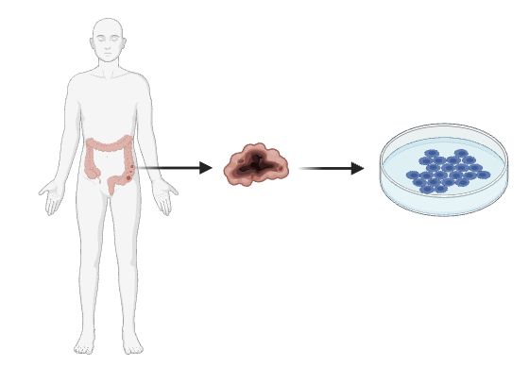
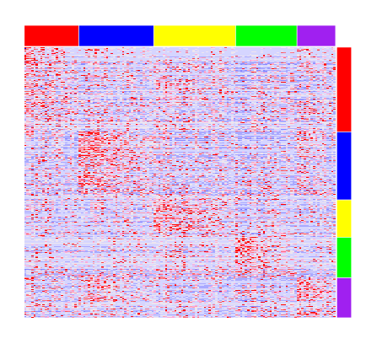
The model
158 in vitro cell lines
149 classified according to the CRIS classifier

Slide 3
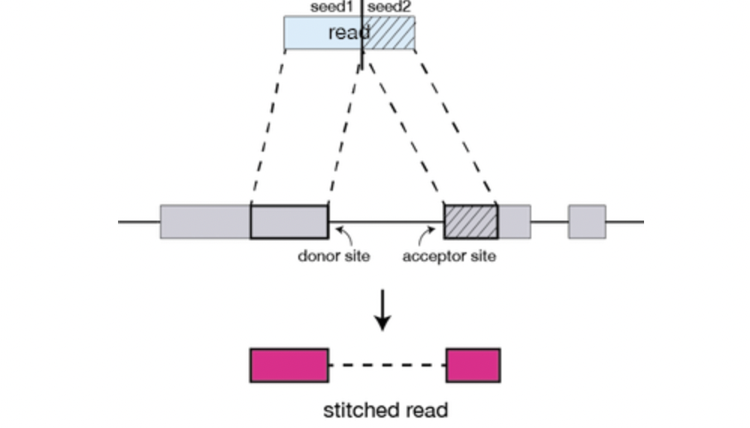
How to detect splicing events
With STAR alignment algoritm, detection of splicing junction can be performed by investigation of the so called “split reads”
The best way to detect them while being completely unbiased is to run star in the so called two pass mode
This means:
1) Running star without using any prior annotation about splice junctions
2) Re-run the alignment step using as annotations the splicing junctions retrieved in the first run
After this process, junctions classified as “un annotated” are more likely to be due to sequencing errors as they would not appear in both run

Slide 4
STAR alignment of RNA sequencing data for in vivo cell lines
Exclusion of
PDX cell lines
Samples with low purity
Samples with no SJ.out.tab
Collect SJ.out.tab file for 136 samples
Aggregation of all splice junctions for all samples
DRAWBACKS
Normalization on the number of assigned usable reads • 10⁶
Experimental procedure, never tested before
It does not allow to quantify alternative splicing events
Difficult to set a trashold to discriminate true events from sequencing errors
For each splice junction, retrieval of number of uniquely mapped reads for each sample

Slide 5
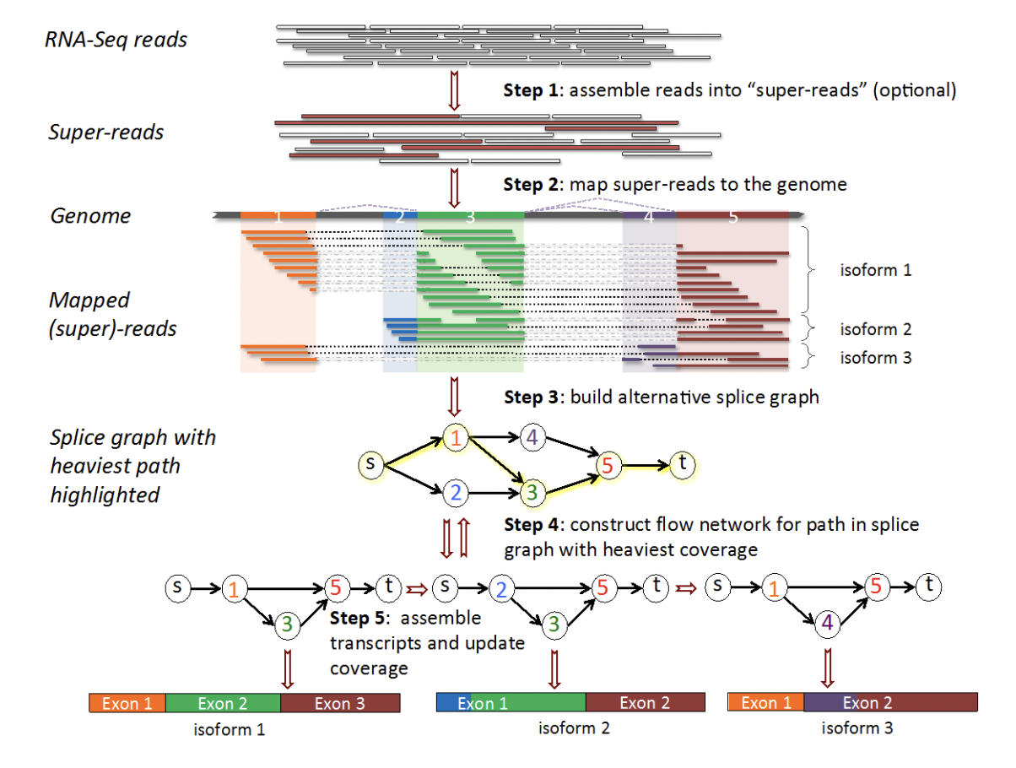
How to discover and quantify alternatively spliced isoforms?
StringTie
Transcript assembly and quantification for RNA-Seq

Slide 6
Stringtie allows detection and quantification of:
Ensembl annotated ranscripts
Not annotated transcripts in which exons can be:
Annotated
Not annotated as exons
Potential intron retention events

Slide 7
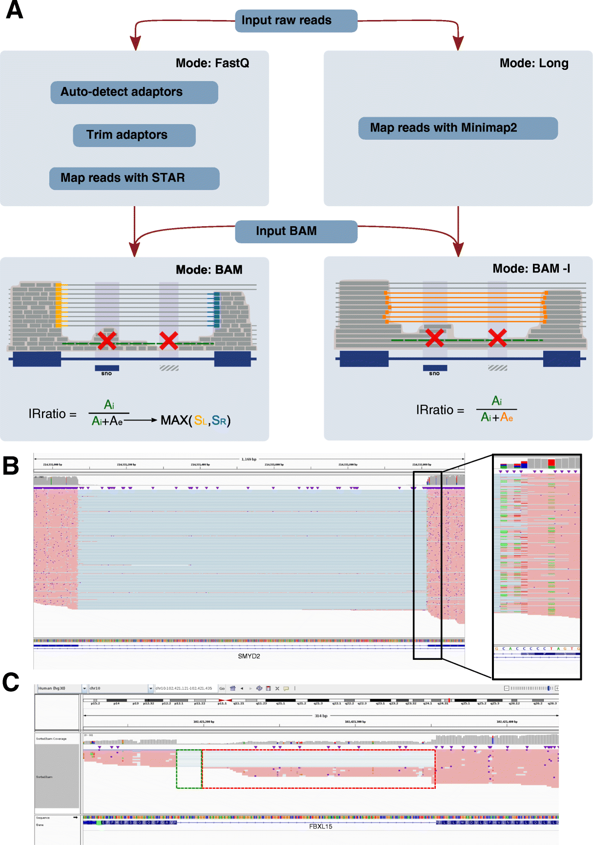
How to detect and quantify de-novo intron retention events?
IRFinder
https://genomebiology.biomedcentral.com/articles/10.1186/s13059-021-02515-8#article-info

Slide 8
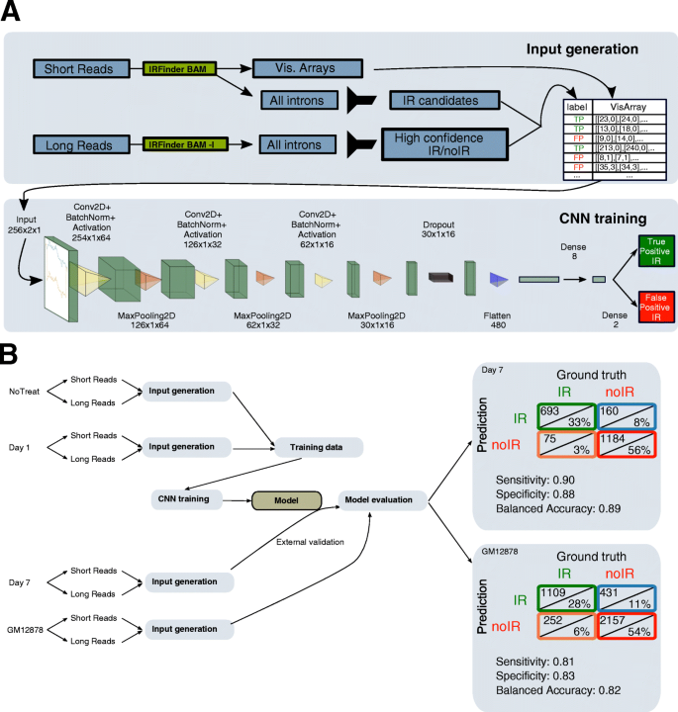
The advantages of using IRFinder
CNN network is used as a filter and selects all IR events with a minimum of 0.05%IR Ratio. It then assigns a IR score, mostly based on a predictive training set

Slide 9
The pipeline
158 samples
STAR
IRFinder
Stringtie
Introns selected yb CNN with a IR-ratio
0.05 (default for IRFinder)
0.1
0.2
0.3
Detection and quantification of isoforms for each gene
Introns detected as exons in not annotated transcripts
CRIS CLASSIFICATION
Charachterization of transcriptional heterogeneity and alterantive splicing events
CRIS CLASSIFICATION
Not annotated introns with strong credibility
ANNOTATED
NOT ANNOTATED
Quantitative comparison among classes
Biotype evaluation
Quantitative comparison among classes
Quantitative comparison among classes
Comparison of biological interpretention ofintrons preferentially found in samples within a CRIS class
Poisson regression model
Ensembl gene informations
Functional analysis of differentially regulated genes
NOT ANNOTATED – ASSIGNED TO A GENOMIC REGION

Slide 10
Definition and relative meaning
Total transcripts
Annotated transcripts
Protein coding transcripts
Annotated intron retention events
Other events
Annotated unassigned
Not anotated transcripts
Not annotated assigned
Not annotated assigned intron retention
Not annotated unassigned

Slide 11
The pipeline
158 samples
STAR
IRFinder
Stringtie
Introns selected yb CNN with a IR-ratio
0.05 (default for IRFinder)
0.1
0.2
0.3
Detection and quantification of isoforms for each gene
Introns detected as exons in not annotated transcripts
CRIS CLASSIFICATION
Charachterization of transcriptional heterogeneity and alterantive splicing events
CRIS CLASSIFICATION
Not annotated introns with strong credibility
ANNOTATED
NOT ANNOTATED
Quantitative comparison among classes
Biotype evaluation
Quantitative comparison among classes
Quantitative comparison among classes
Comparison of biological interpretention ofintrons preferentially found in samples within a CRIS class
Poisson regression model
Ensembl gene informations
Functional analysis of differentially regulated genes
NOT ANNOTATED – ASSIGNED TO A GENOMIC REGION

Slide 12
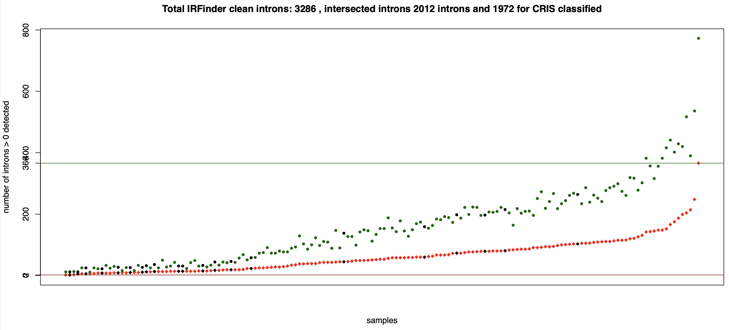
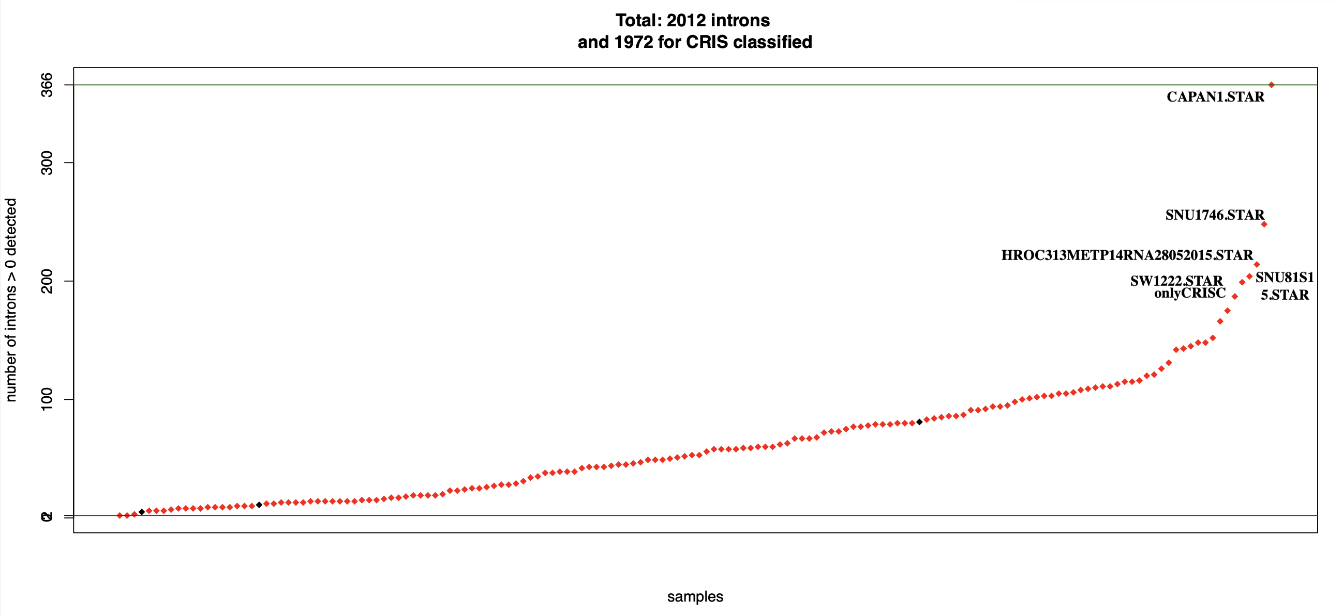
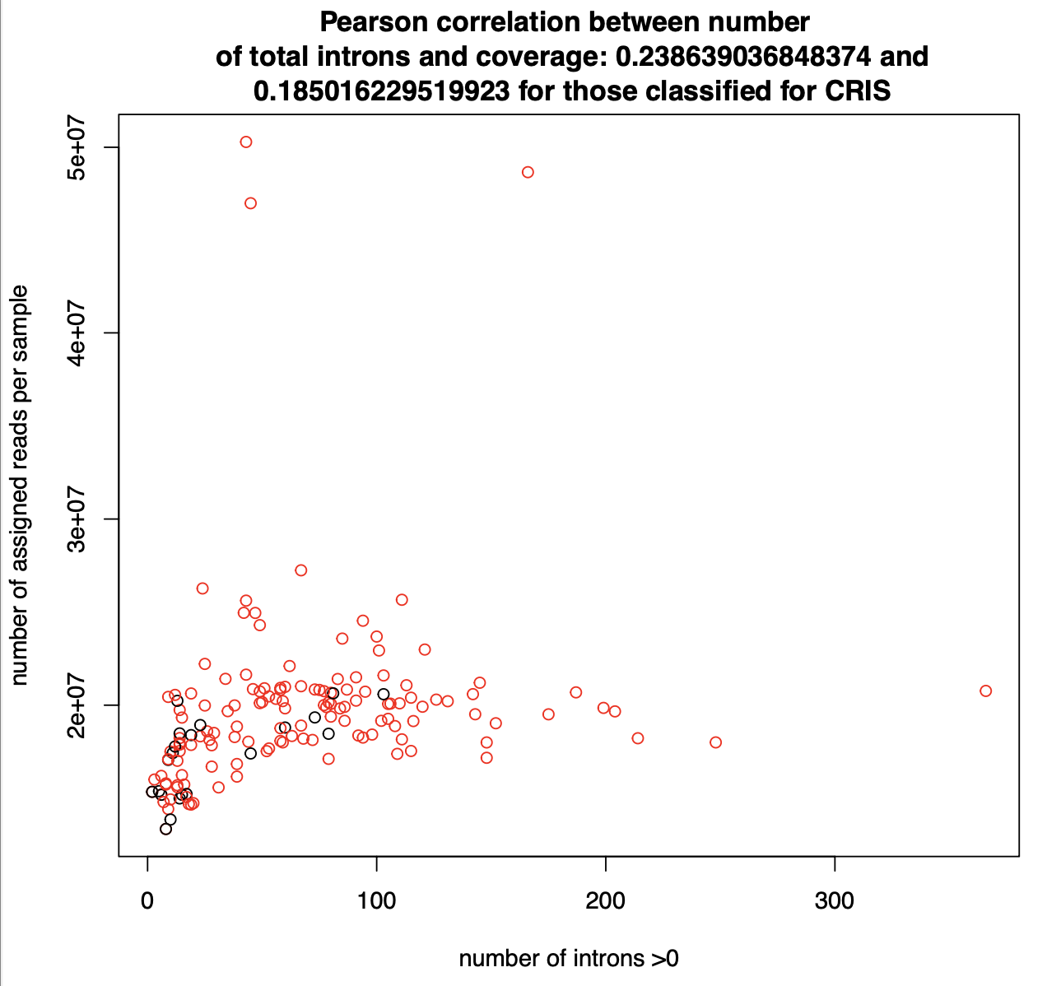
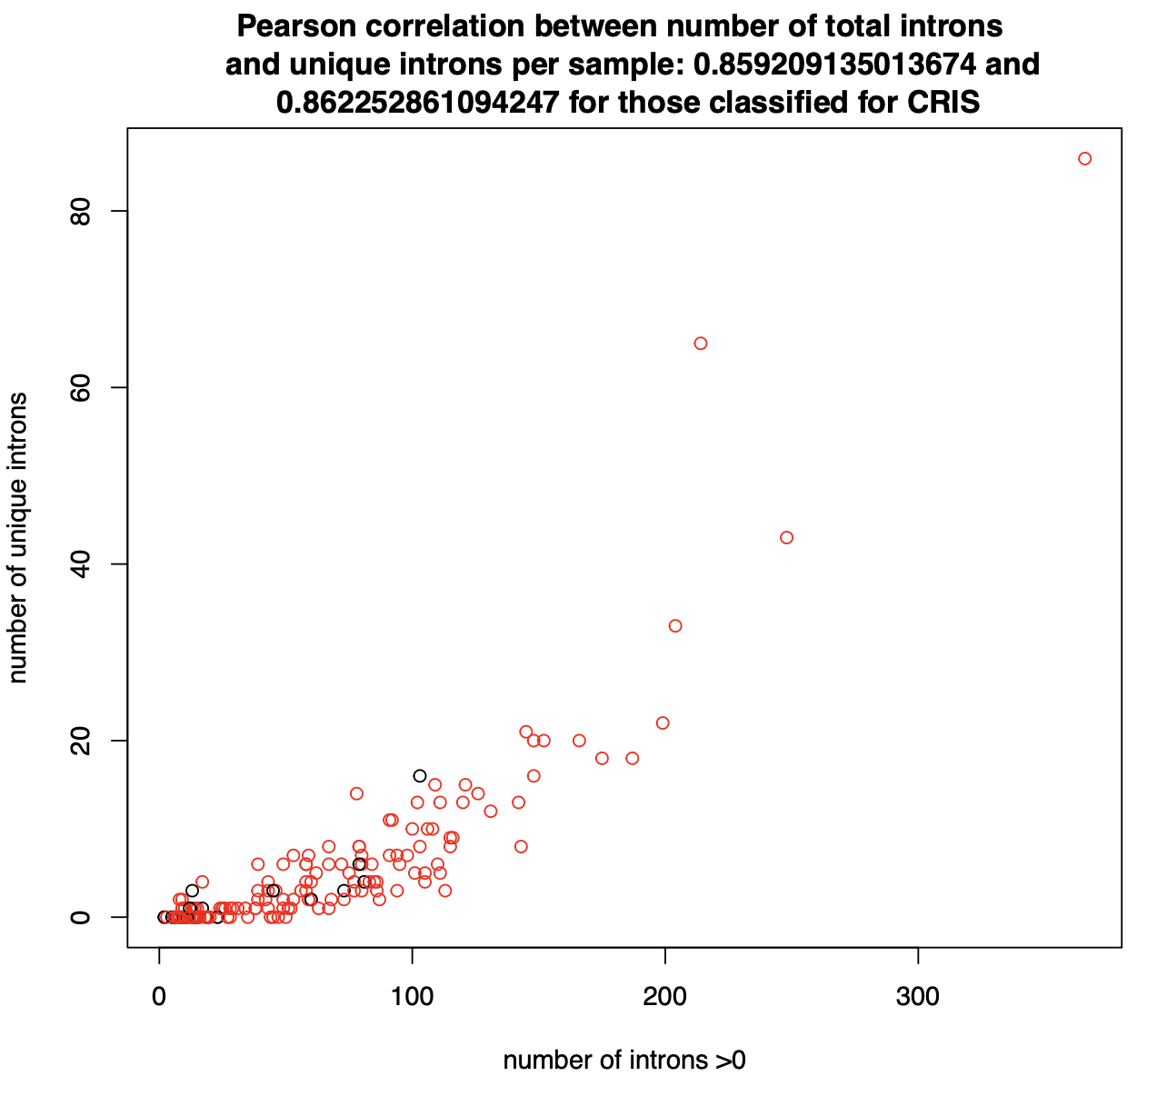
For a cutoff of 30 %

Slide 13
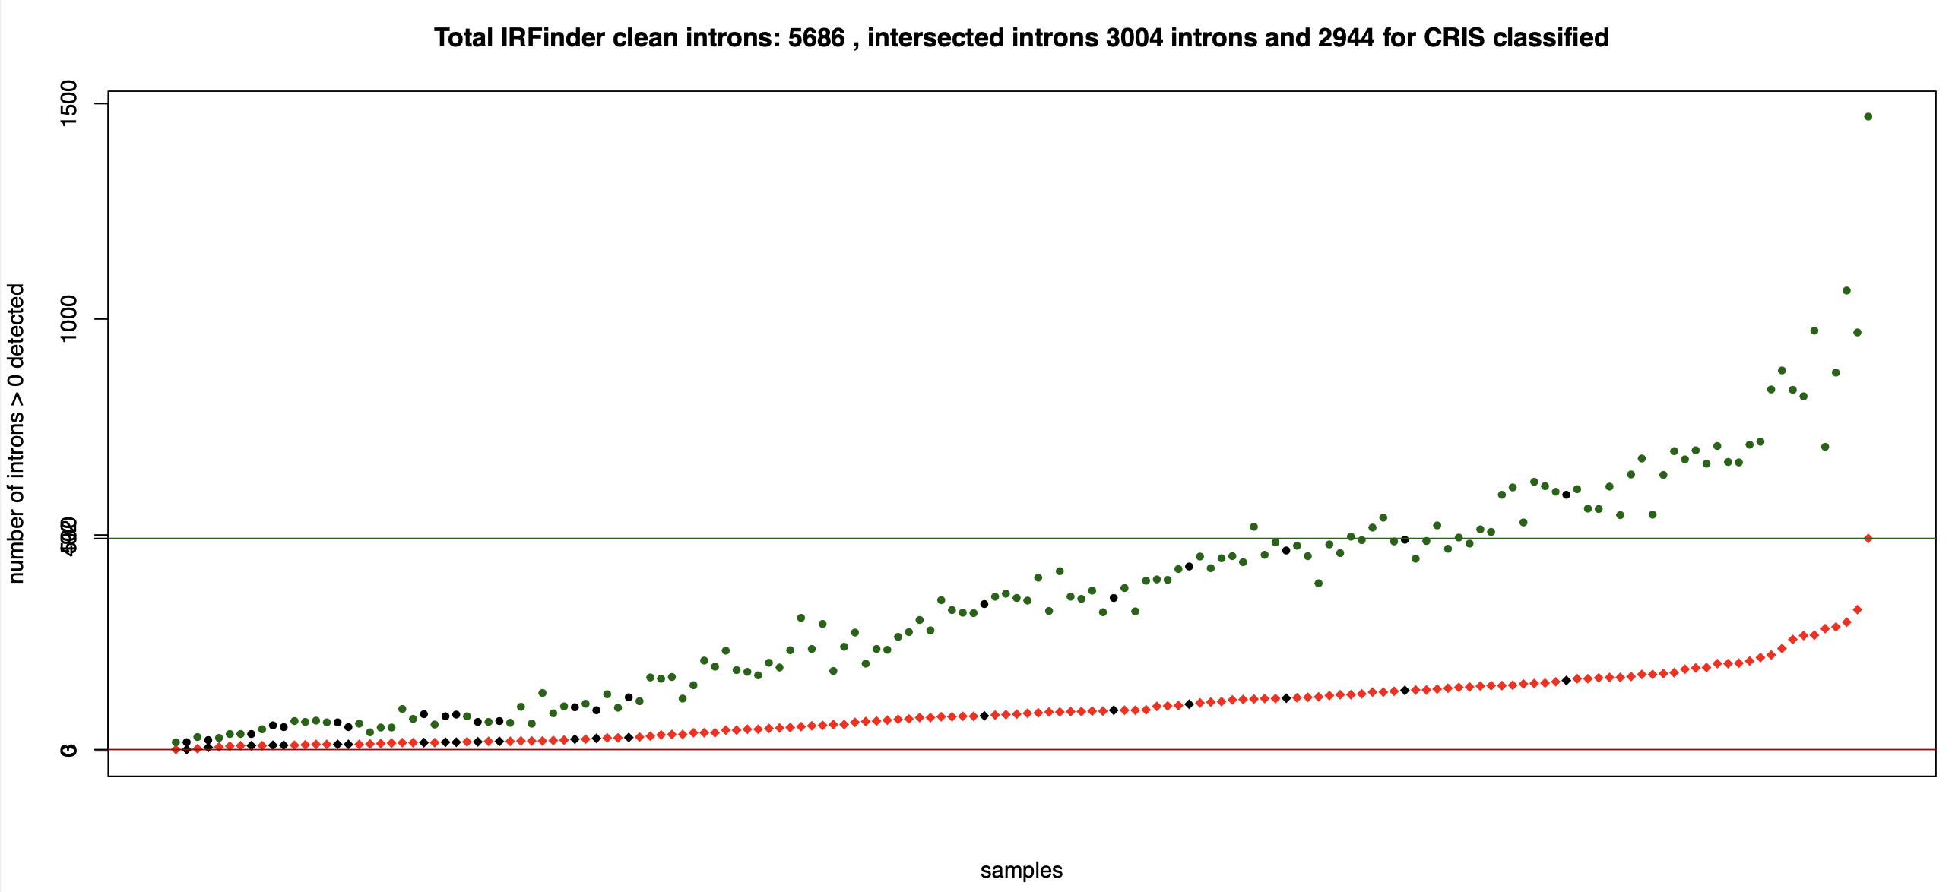
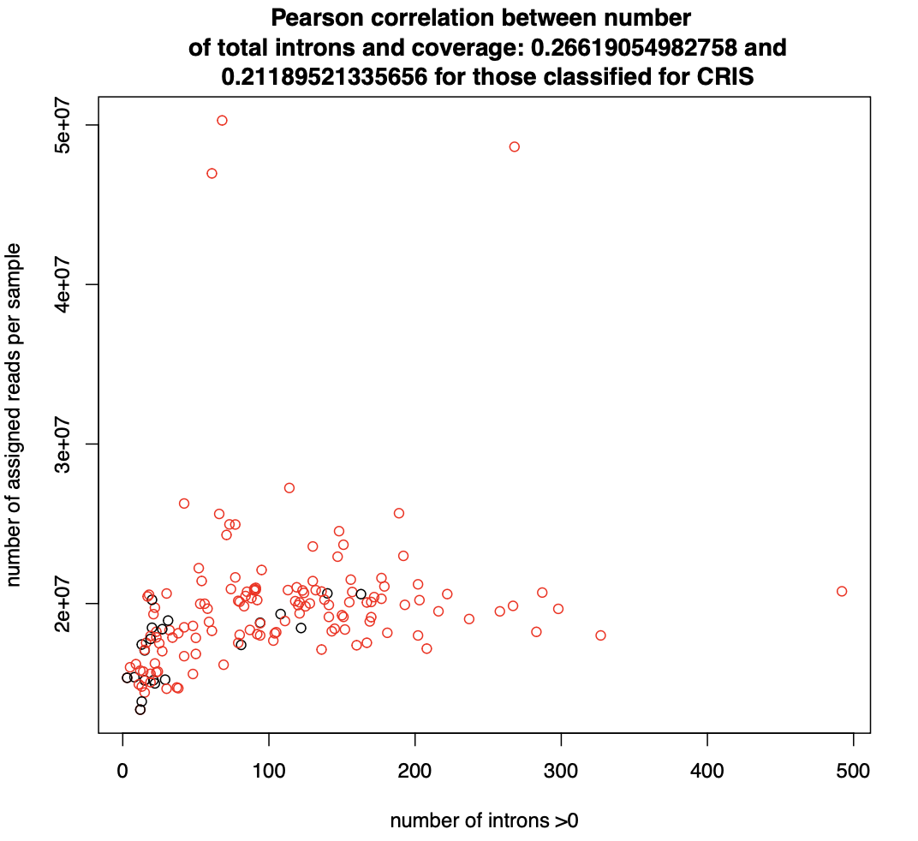
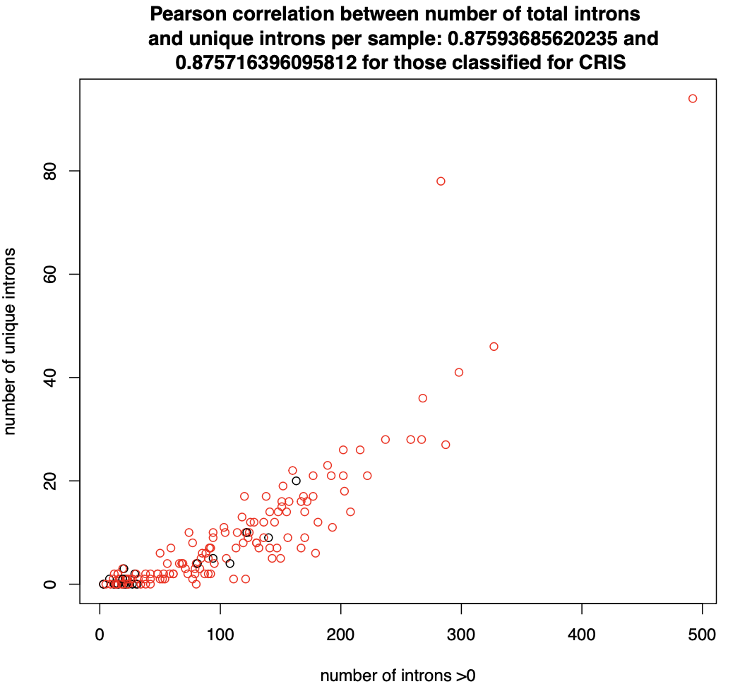
For a cutoff of 20 %

Slide 14
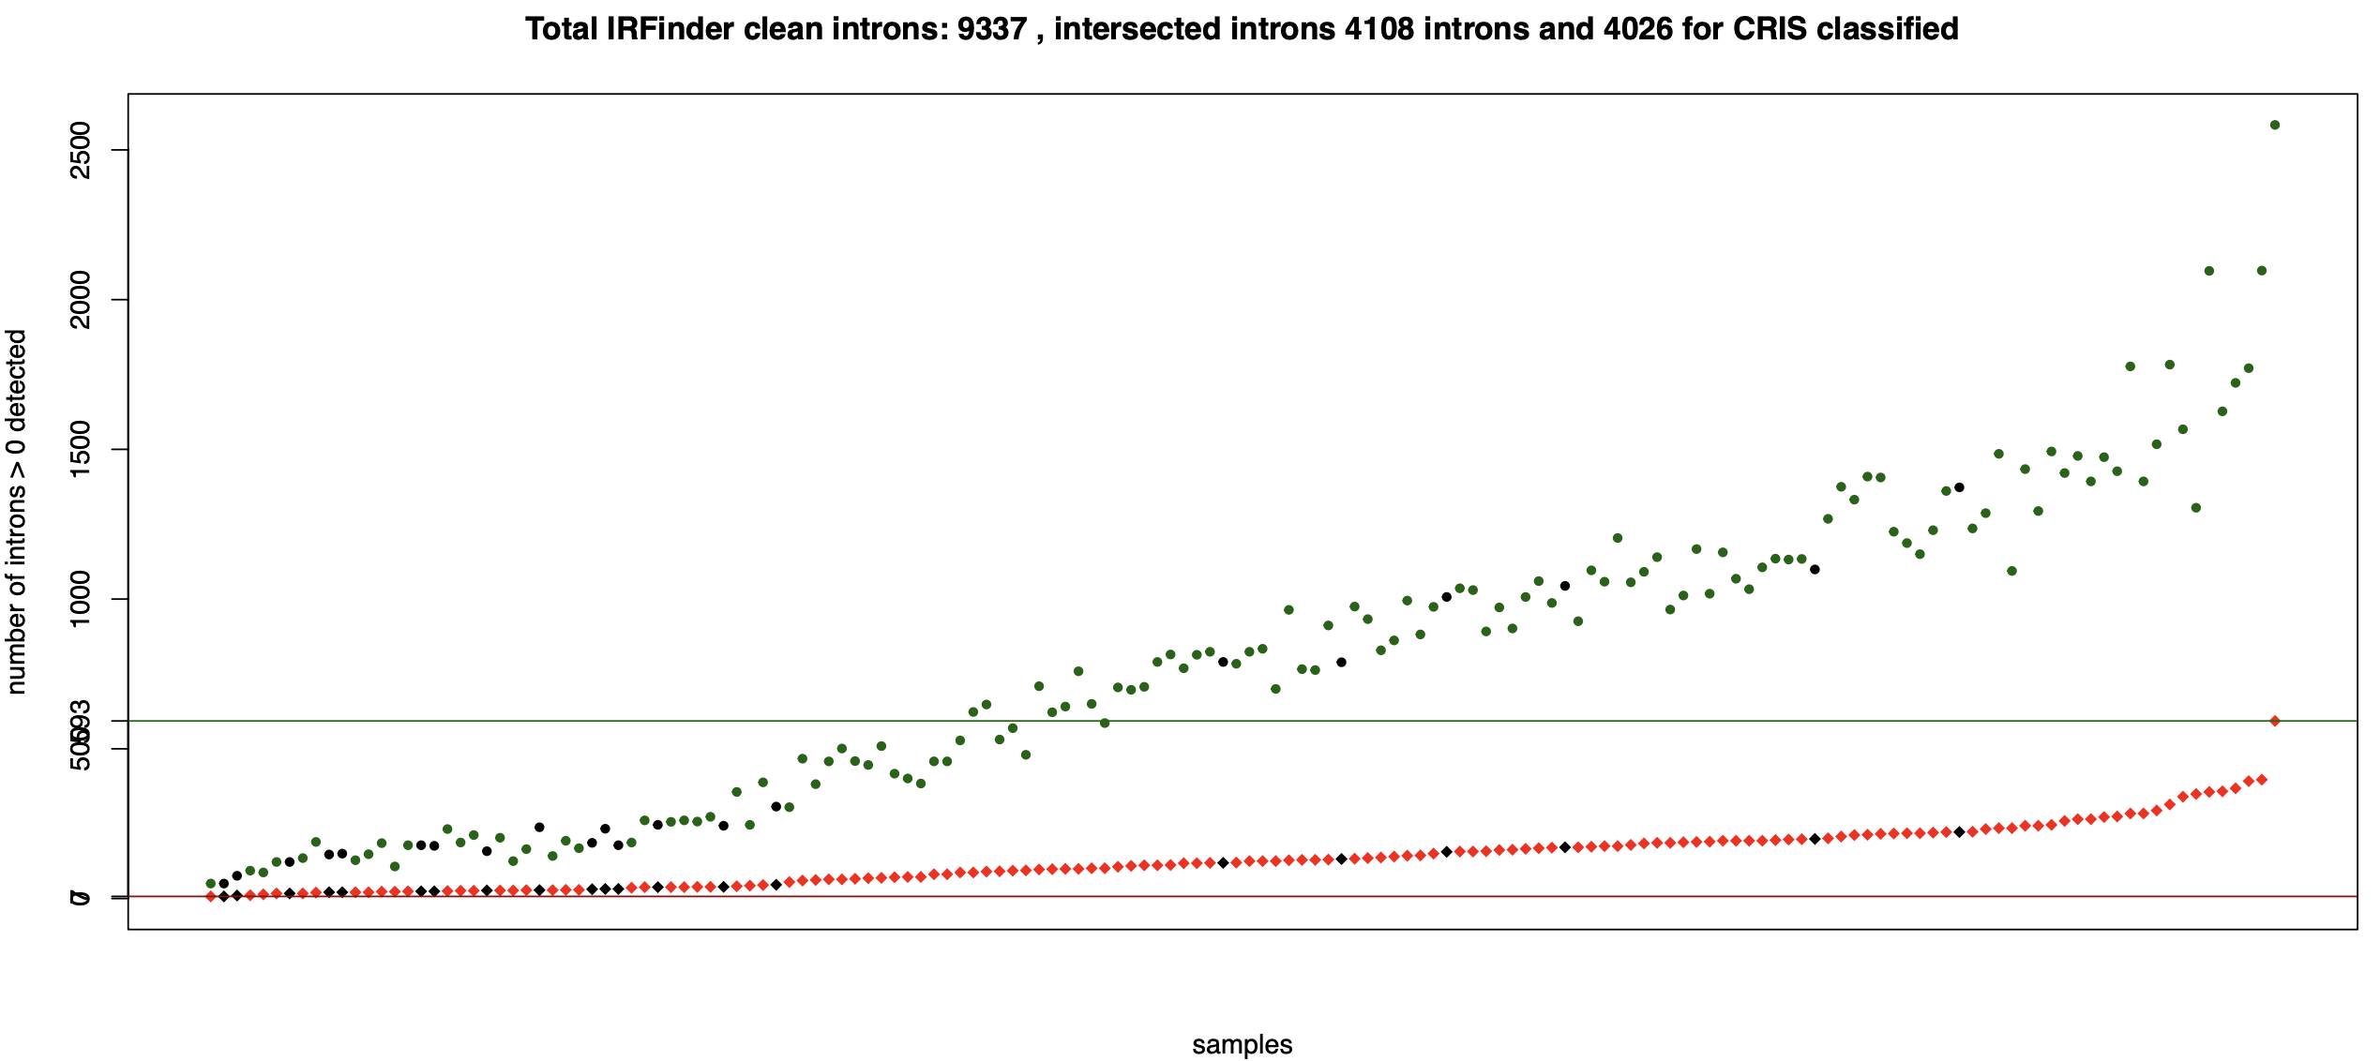
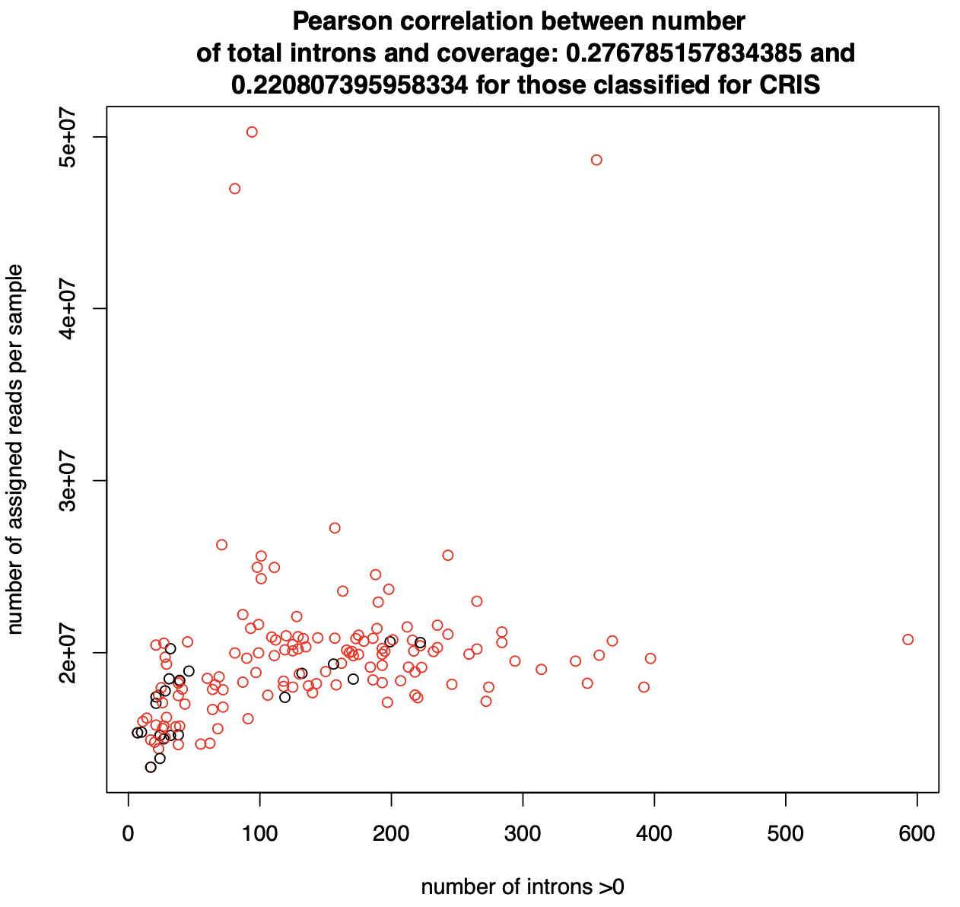
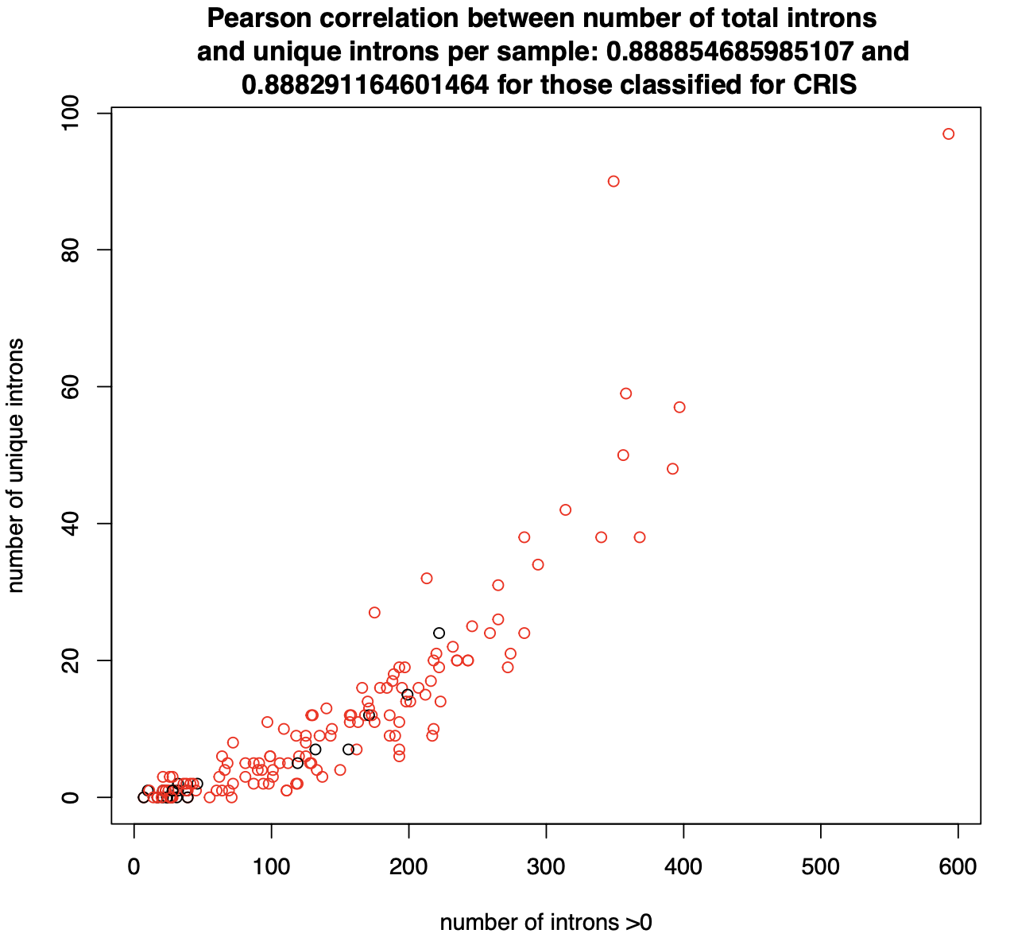
For a cutoff of 10 %

Slide 15

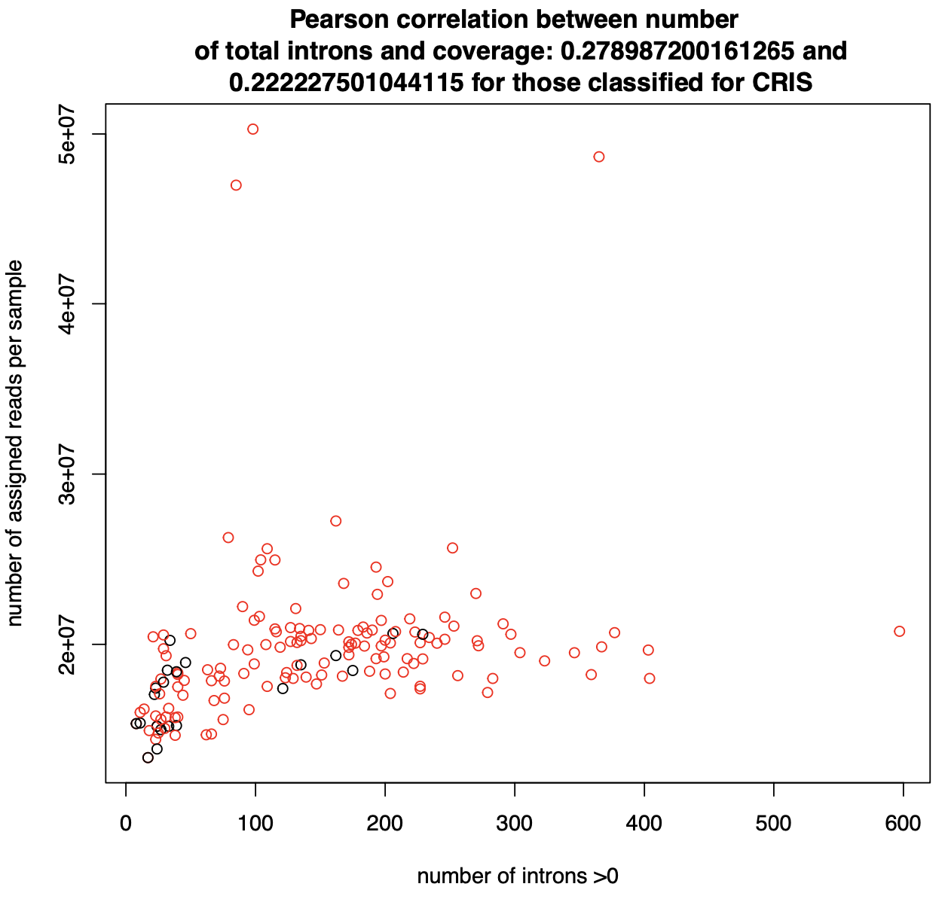
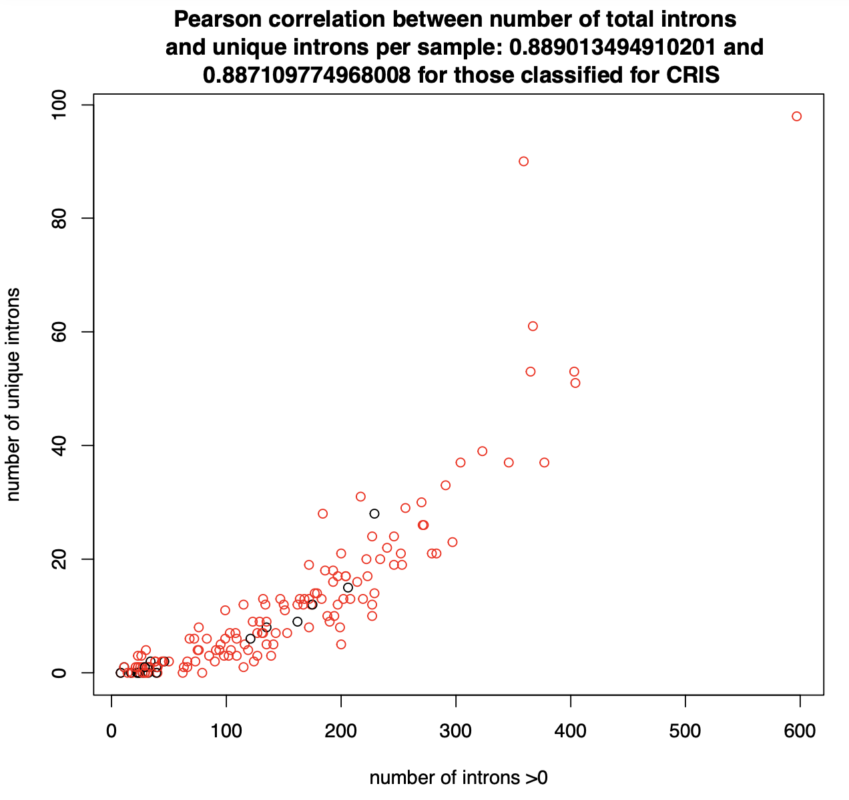
For a cutoff of 5 %

Slide 16
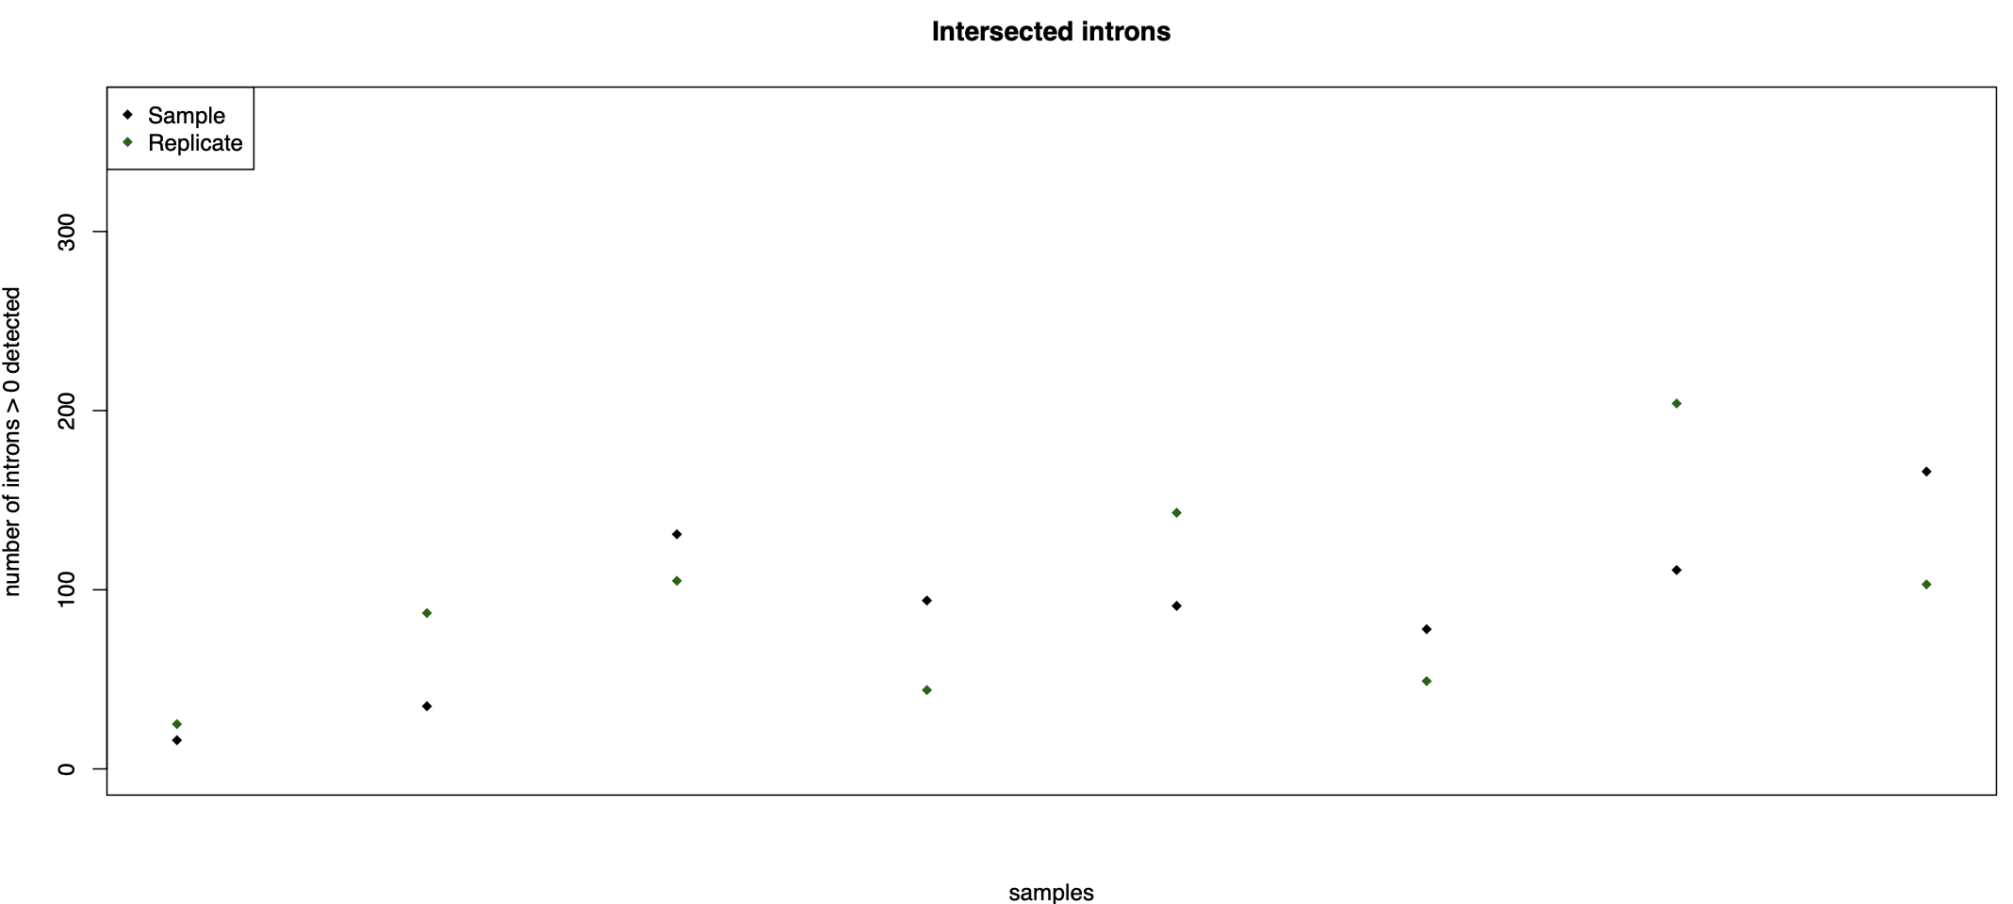
How do replicates perform in terms of coverage and total intron number?
At cutoff 0.03 this is the reproducibility in terms of total number maximum difference is of 93 for SNU81.STAR
Quantiles:
0% 25% 50% 75% 100%
9.00 28.25 51.00 54.75 93.00

Slide 17
The pipeline
158 samples
STAR
IRFinder
Stringtie
Introns selected yb CNN with a IR-ratio
0.05 (default for IRFinder)
0.1
0.2
0.3
Detection and quantification of isoforms for each gene
Introns detected as exons in not annotated transcripts
CRIS CLASSIFICATION
Charachterization of transcriptional heterogeneity and alterantive splicing events
CRIS CLASSIFICATION
Not annotated introns with strong credibility
ANNOTATED
NOT ANNOTATED
Quantitative comparison among classes
Biotype evaluation
Quantitative comparison among classes
Quantitative comparison among classes
Comparison of biological interpretention ofintrons preferentially found in samples within a CRIS class
Poisson regression model
Ensembl gene informations
Functional analysis of differentially regulated genes
NOT ANNOTATED – ASSIGNED TO A GENOMIC REGION

Slide 18
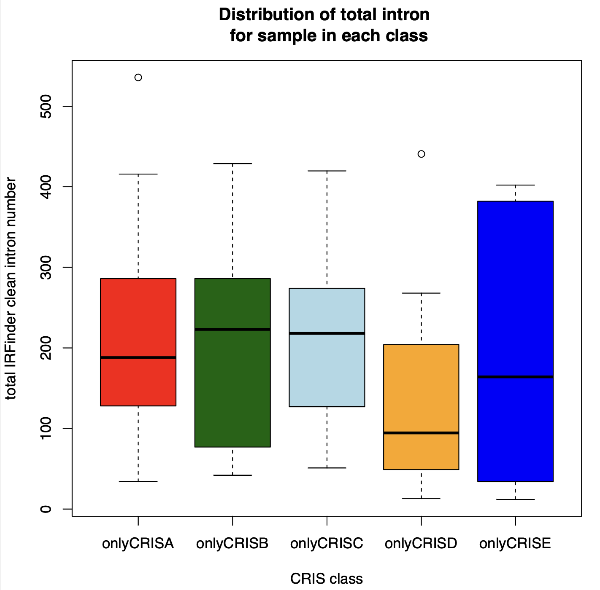
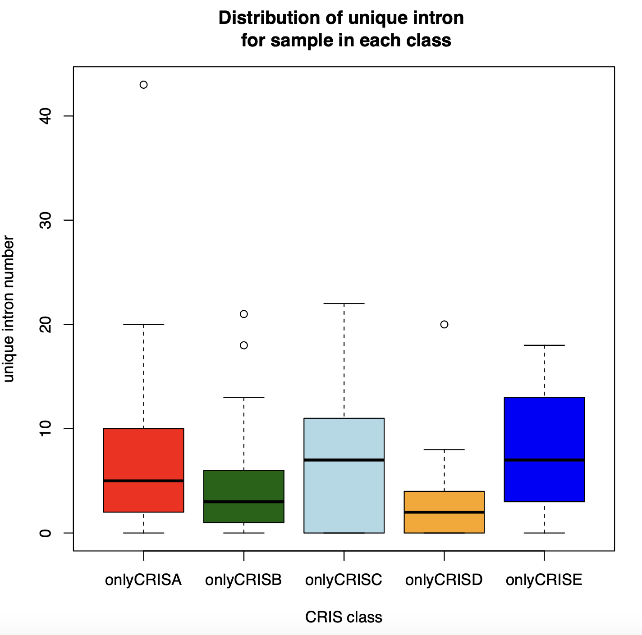
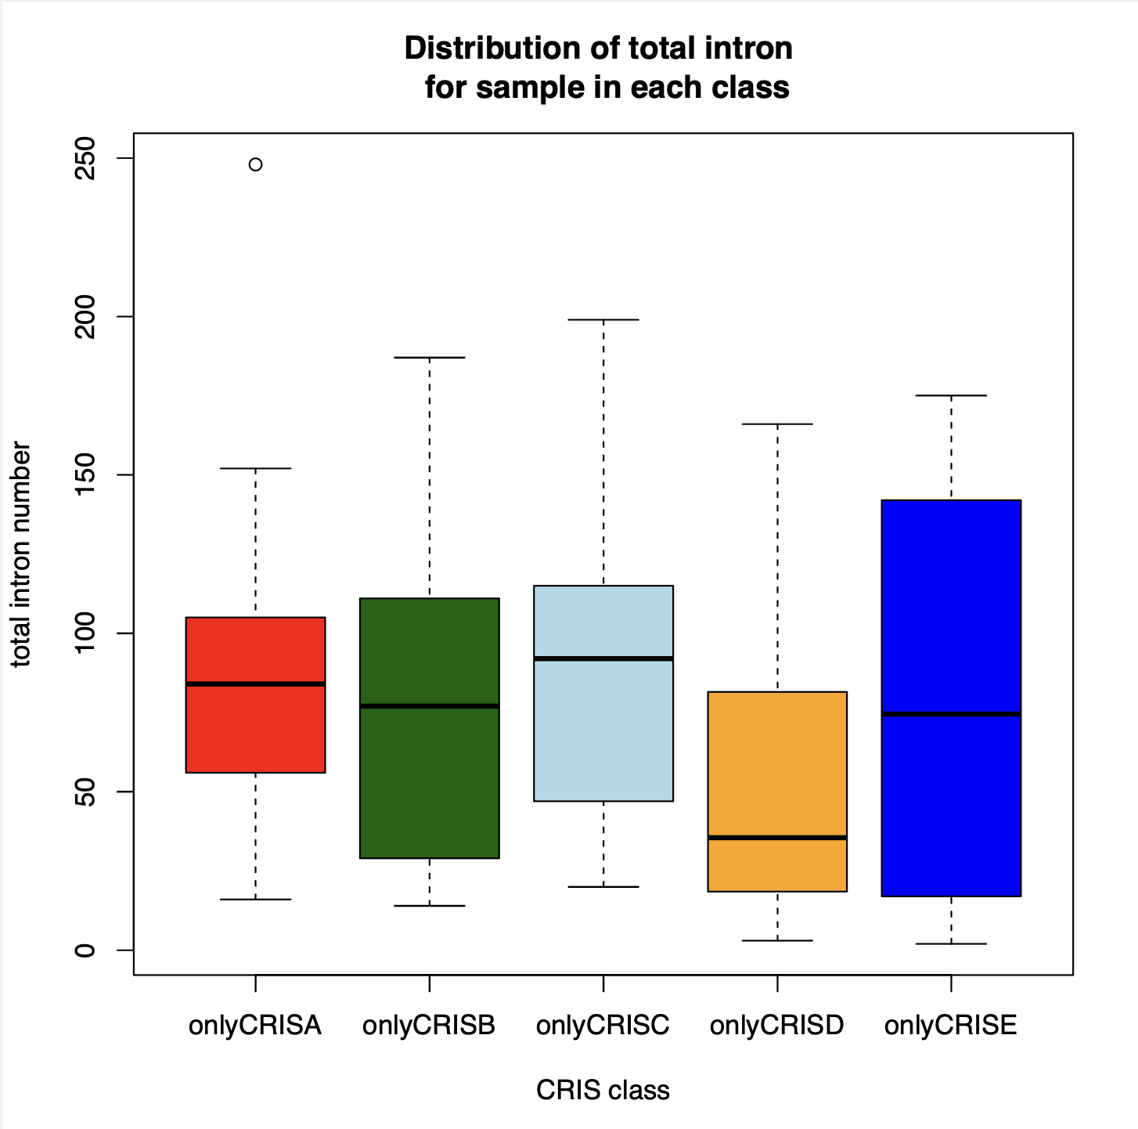
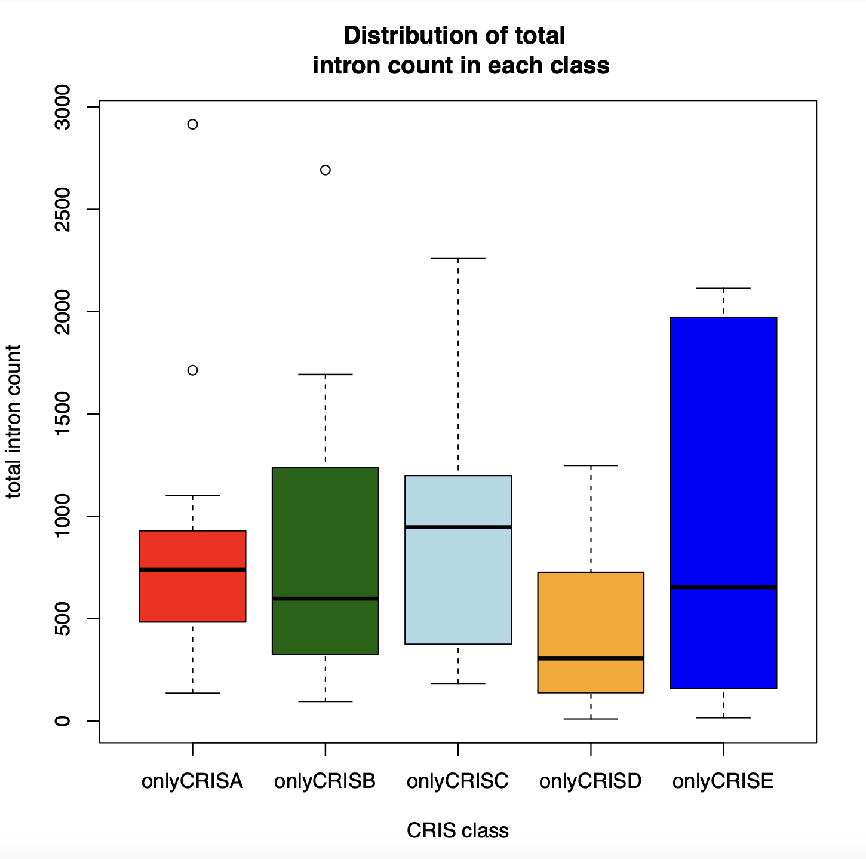
Quantitative comparison - 30%

Slide 19
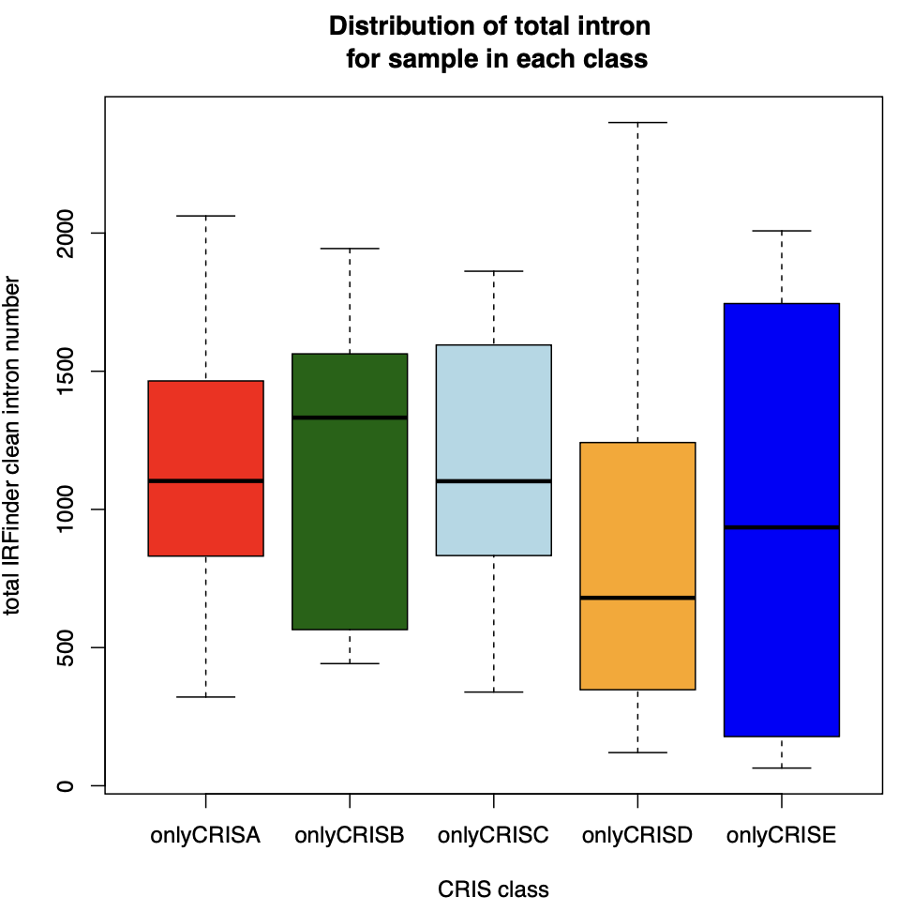
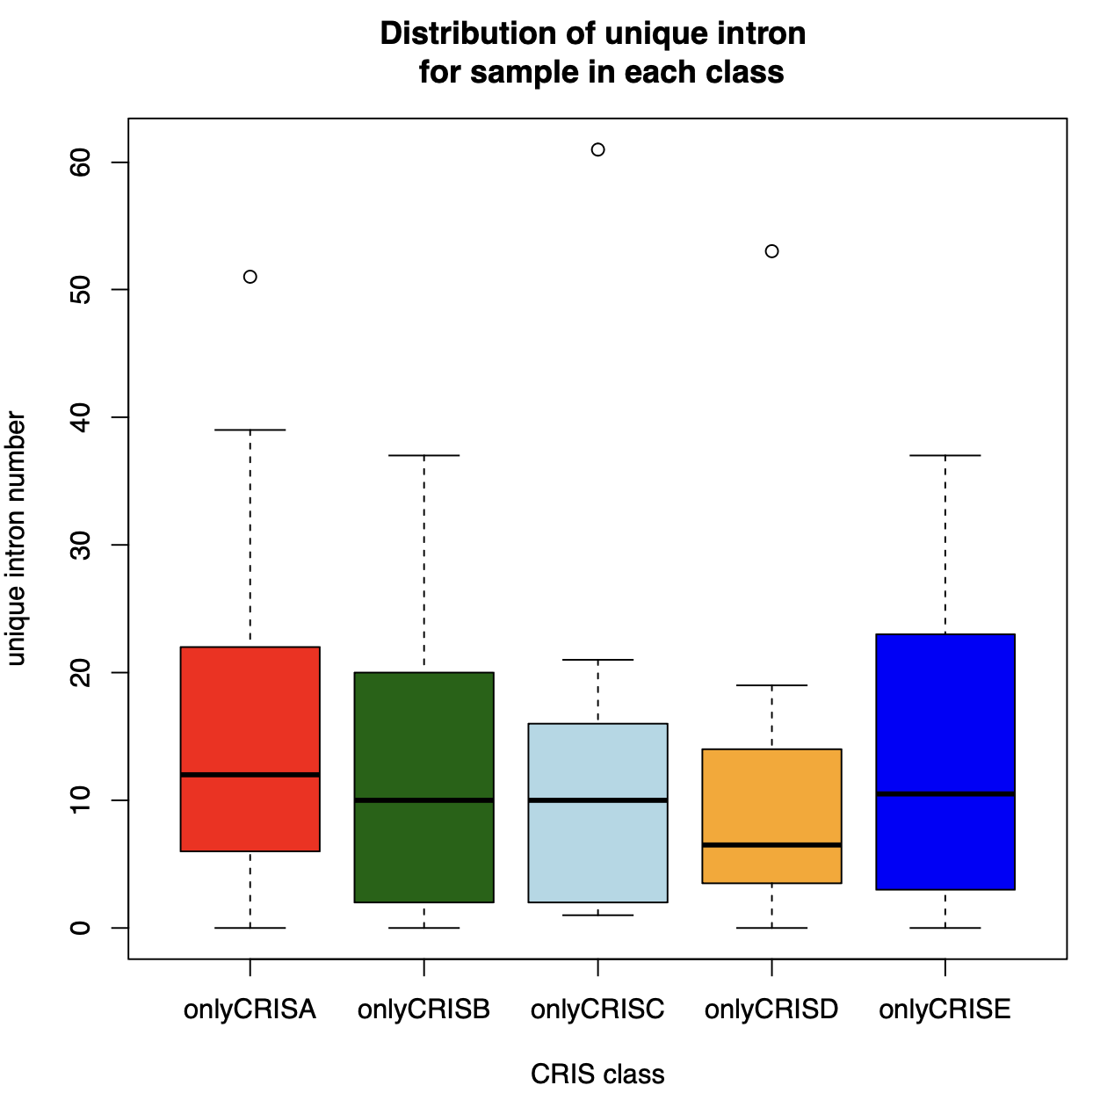
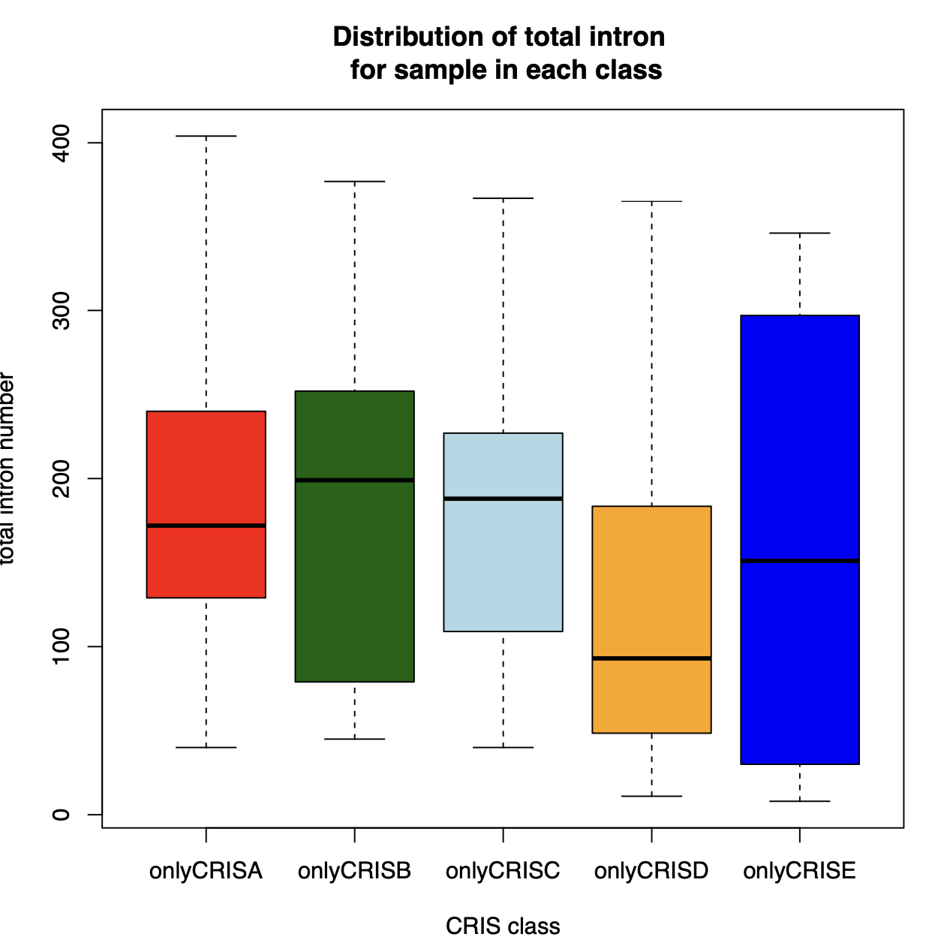
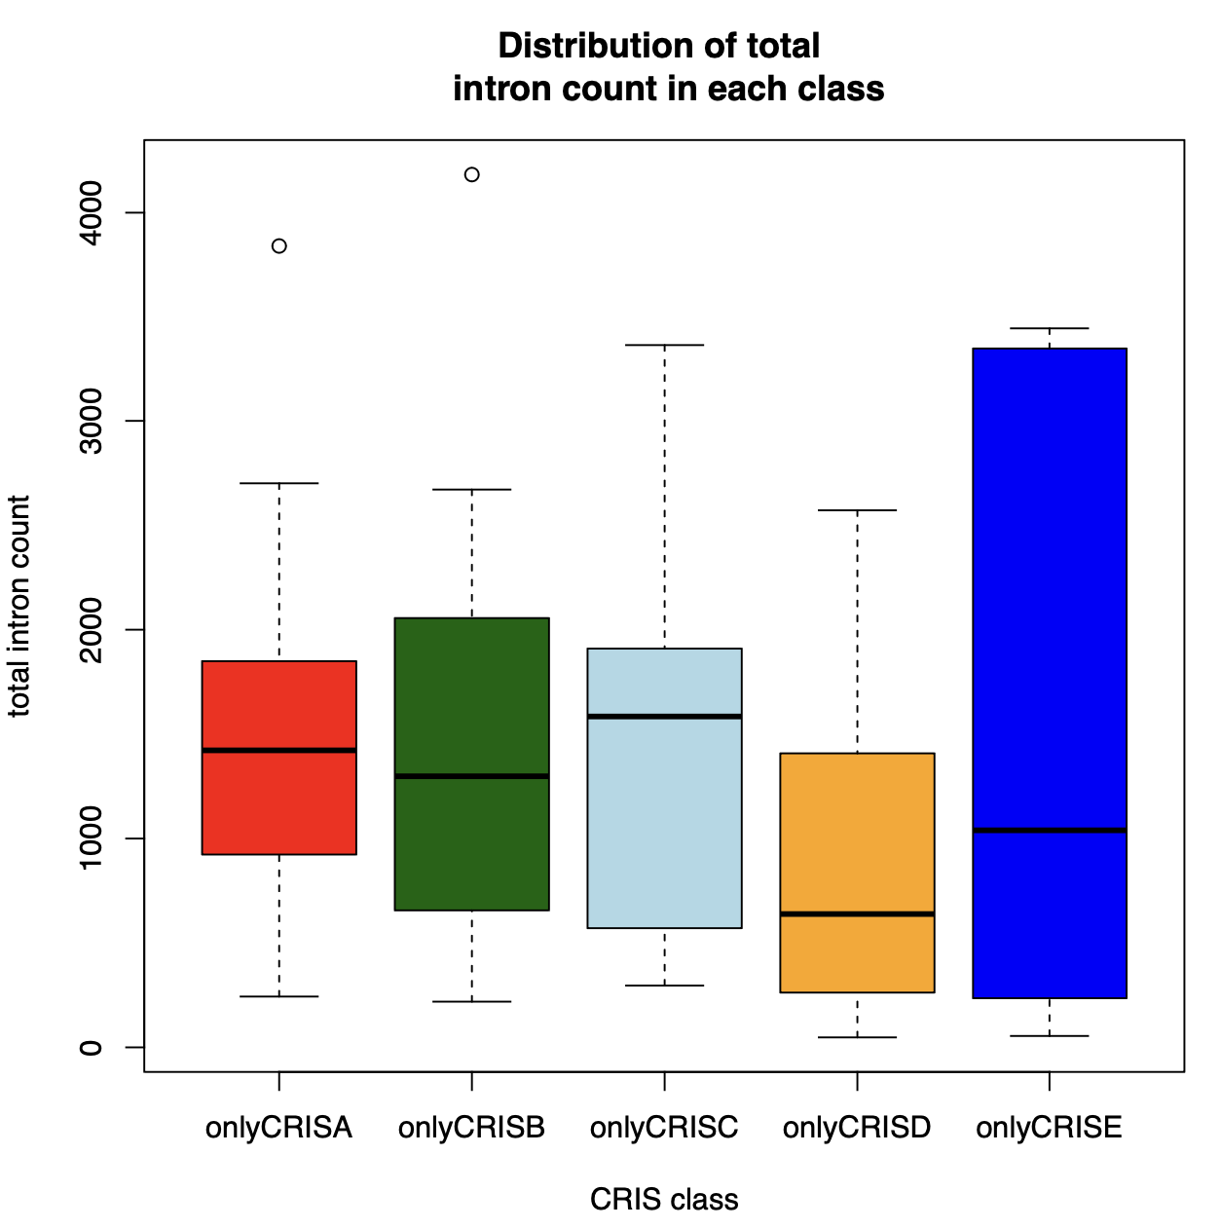
Quantitative comparison - 5%

Slide 20
The pipeline
158 samples
STAR
IRFinder
Stringtie
Introns selected yb CNN with a IR-ratio
0.05 (default for IRFinder)
0.1
0.2
0.3
Detection and quantification of isoforms for each gene
Introns detected as exons in not annotated transcripts
CRIS CLASSIFICATION
Charachterization of transcriptional heterogeneity and alterantive splicing events
CRIS CLASSIFICATION
Not annotated introns with strong credibility
ANNOTATED
NOT ANNOTATED
Quantitative comparison among classes
Biotype evaluation
Quantitative comparison among classes
Quantitative comparison among classes
Comparison of biological interpretention ofintrons preferentially found in samples within a CRIS class
Poisson regression model
Ensembl gene informations
Functional analysis of differentially regulated genes
NOT ANNOTATED – ASSIGNED TO A GENOMIC REGION

Slide 21
Distribution of class specific introns
Cutoff at 30% - de novo events in uniquely classified cris samples not present in samples which are not within that class |  |  |  |  |  |  |  | Cutoff at 30% - de novo events in samples according to primary cris classification and not present in samples which are not within that class
 | CRISA | CRISB | CRISC | CRISD | CRISE |  |  |  | CRISA | CRISB | CRISC | CRISD | CRISE
total introns | 141 | 137 | 74 | 61 | 56 |  |  | total introns | 152 | 278 | 109 | 88 | 60
maximum shared | 3 | 3 | 2 | 2 | 2 |  |  | maximum shared | 3 | 4 | 3 | 2 | 2
Cutoff at 20% - de novo events in uniquely classified cris samples not present in samples which are not within that class |  |  |  |  |  |  |  | Cutoff at 20% - de novo events in samples according to primary cris classification and not present in samples which are not within that class
 | CRISA | CRISB | CRISC | CRISD | CRISE |  |  |  | CRISA | CRISB | CRISC | CRISD | CRISE
total introns | 205 | 213 | 104 | 121 | 81 |  |  | total introns | 220 | 392 | 159 | 163 | 87
maximum shared | 3 | 3 | 2 | 2 | 1 |  |  | maximum shared | 3 | 4 | 2 | 2 | 2
Cutoff at 10% - de novo events in uniquely classified cris samples not present in samples which are not within that class |  |  |  |  |  |  |  | Cutoff at 10% - de novo events in samples according to primary cris classification and not present in samples which are not within that class
 | CRISA | CRISB | CRISC | CRISD | CRISE |  |  |  | CRISA | CRISB | CRISC | CRISD | CRISE
total introns | 250 | 287 | 150 | 162 | 97 |  |  | total introns | 275 | 516 | 219 | 226 | 110
maximum shared | 3 | 3 | 2 | 2 | 2 |  |  | maximum shared | 3 | 5 | 3 | 3 | 2
Cutoff at 5% - de novo events in uniquely classified cris samples not present in samples which are not within that class |  |  |  |  |  |  |  | Cutoff at 5% - de novo events in samples according to primary cris classification and not present in samples which are not within that class
 | CRISA | CRISB | CRISC | CRISD | CRISE |  |  |  | CRISA | CRISB | CRISC | CRISD | CRISE
total introns | 250 | 301 | 154 | 169 | 99 |  |  | total introns | 274 | 531 | 232 | 233 | 115
maximum shared | 3 | 3 | 2 | 2 | 2 |  |  | maximum shared | 3 | 5 | 3 | 3 | 2

Slide 22
FUNCTIONAL ANALYSIS
Enrichment analysis with gene sets from WikiPathways
p-value calculated by fisher test
Log2ratio calculated as Log2 Observed/Expected
Focus on pathway over functionality of the genes, to understand possible regulators
FUTURE PERSPECTIVES: could it be helpful to perform enrichment over transcription factor?

Slide 23
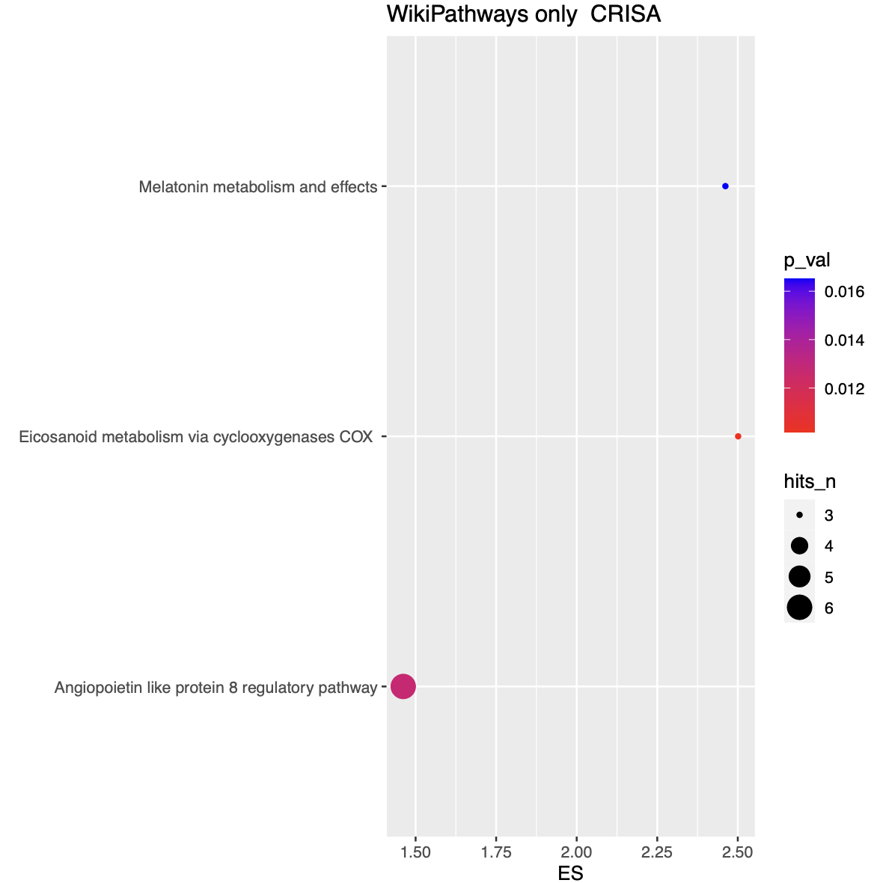
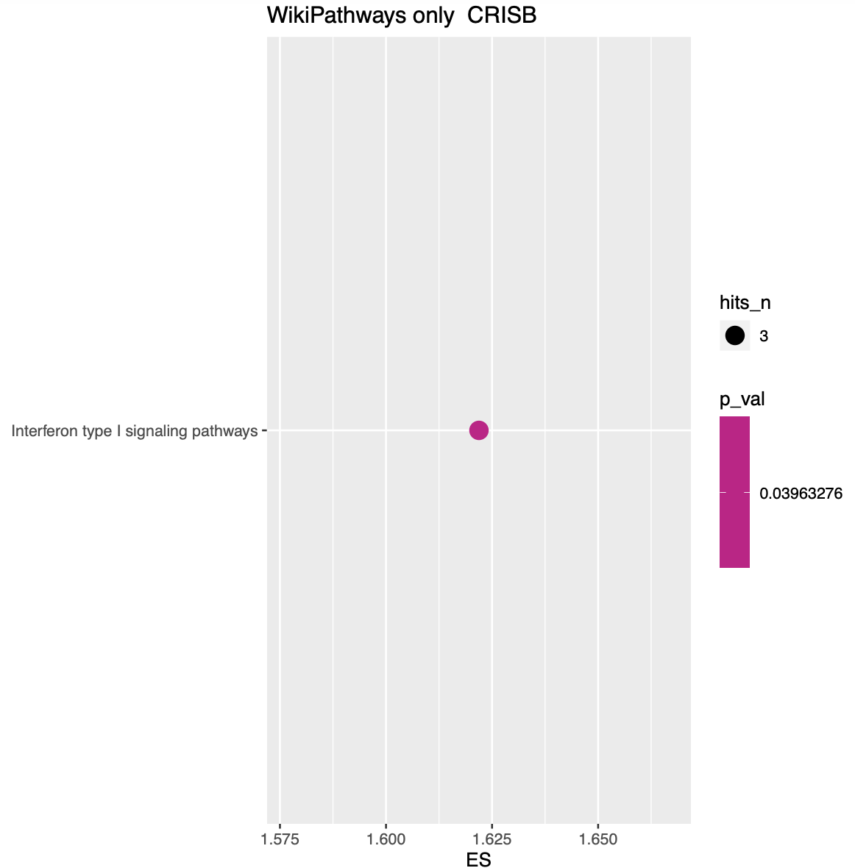
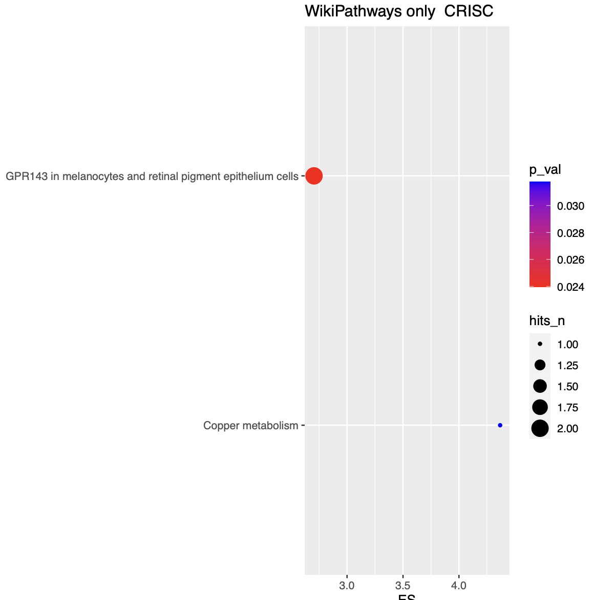
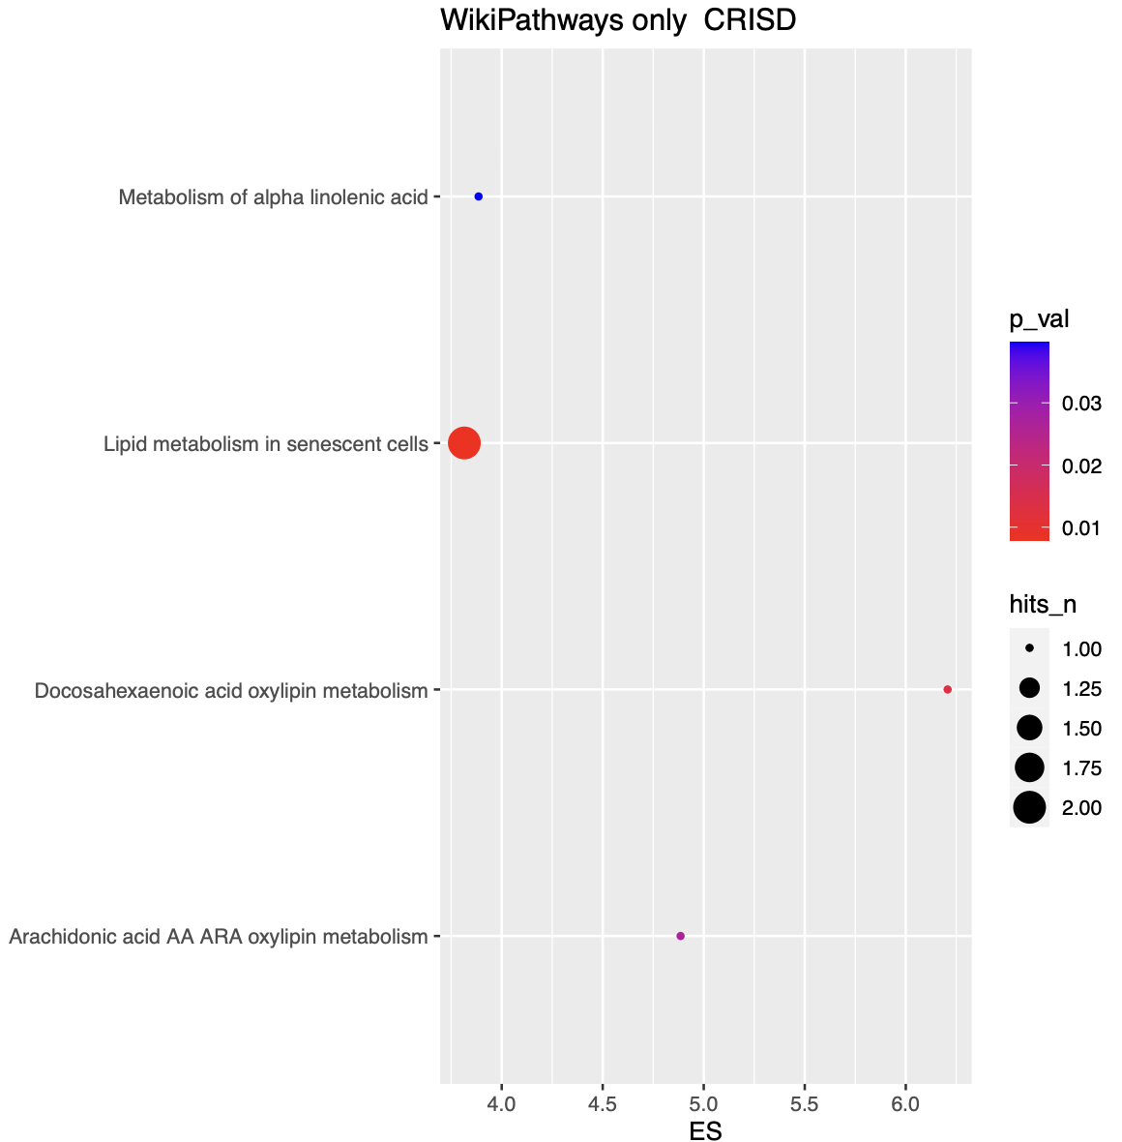
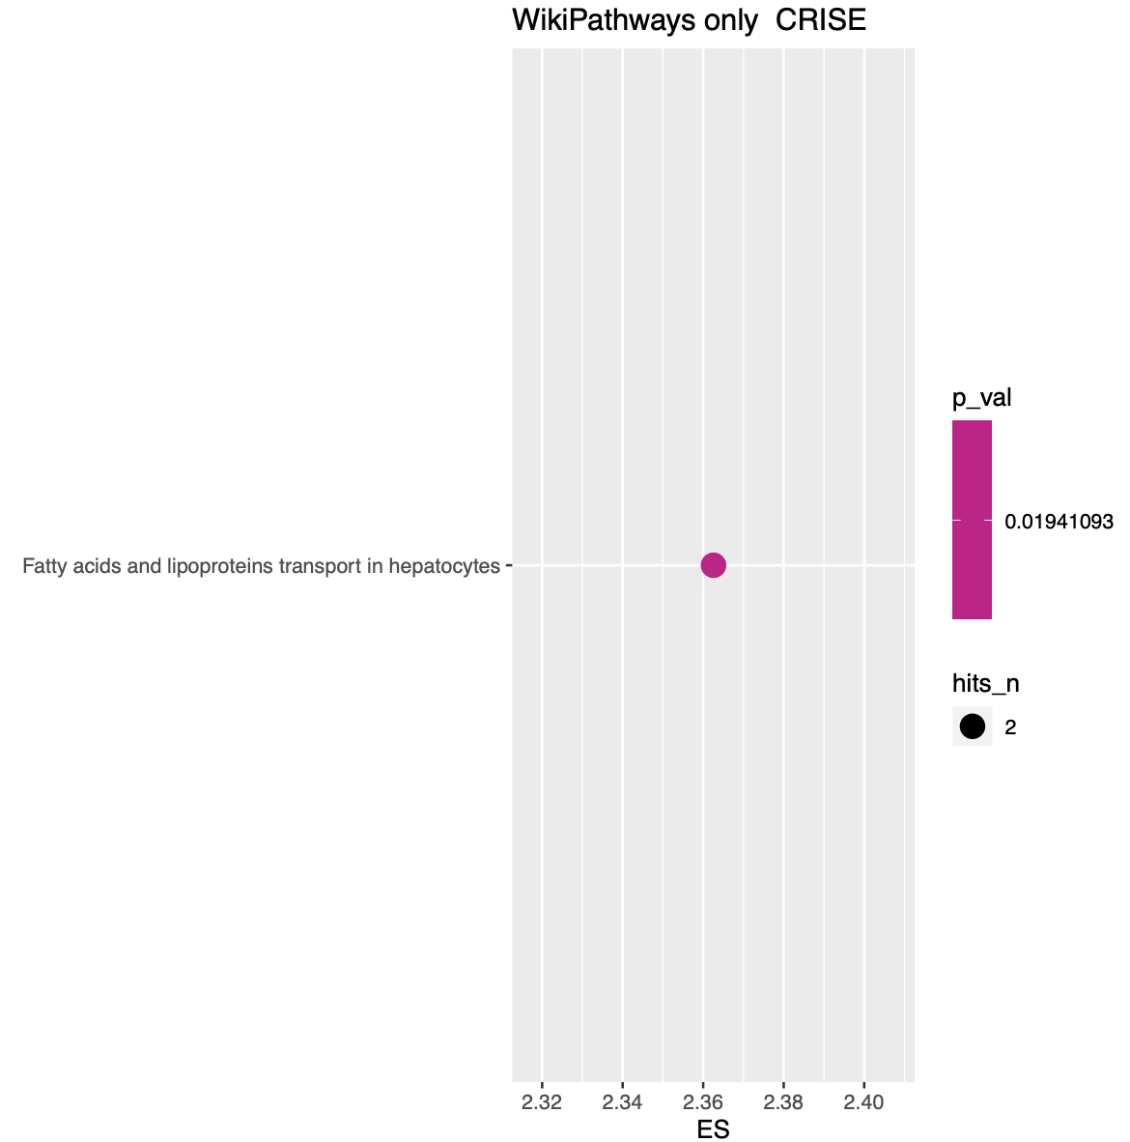
Cutoff 30% univoquely defined CRIS samples only

Slide 24
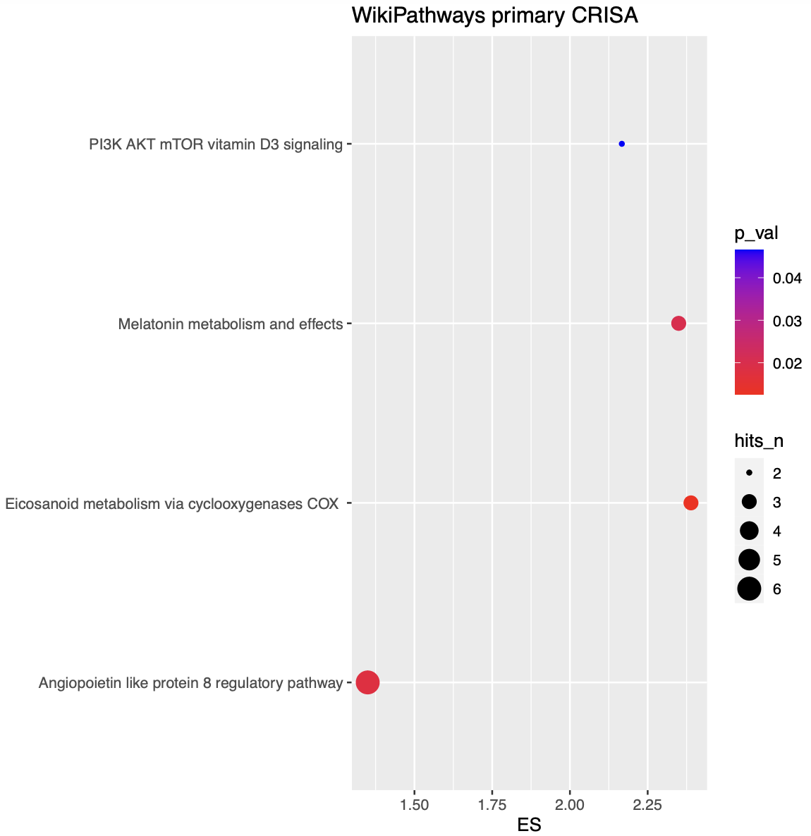
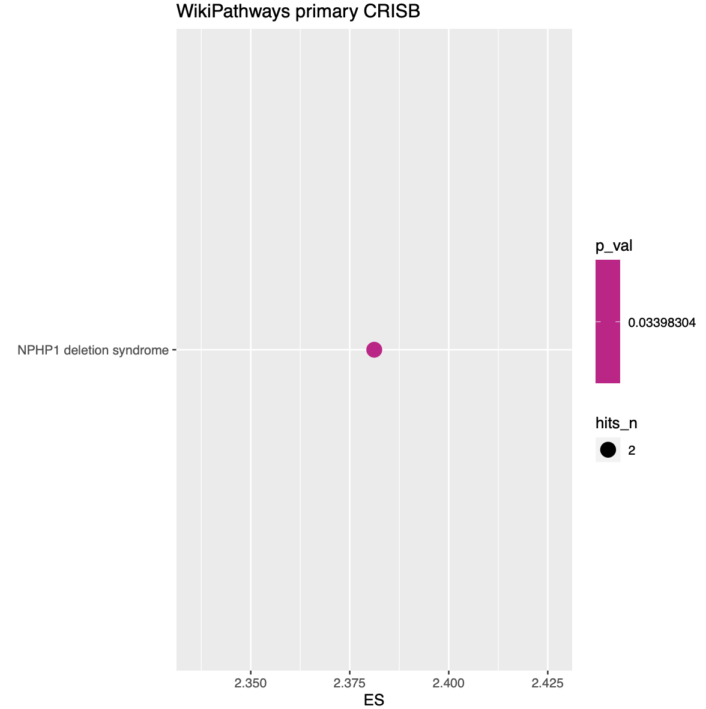
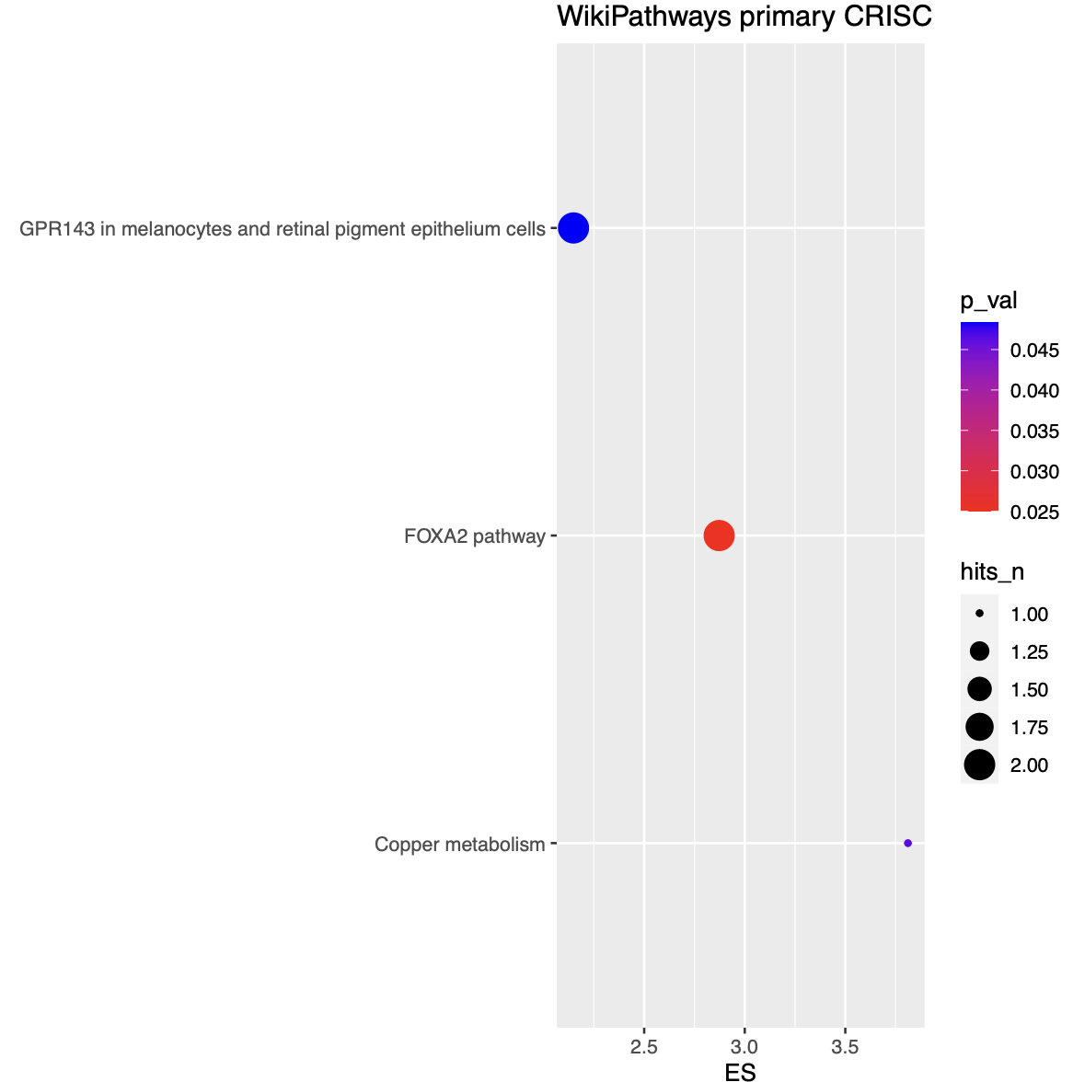
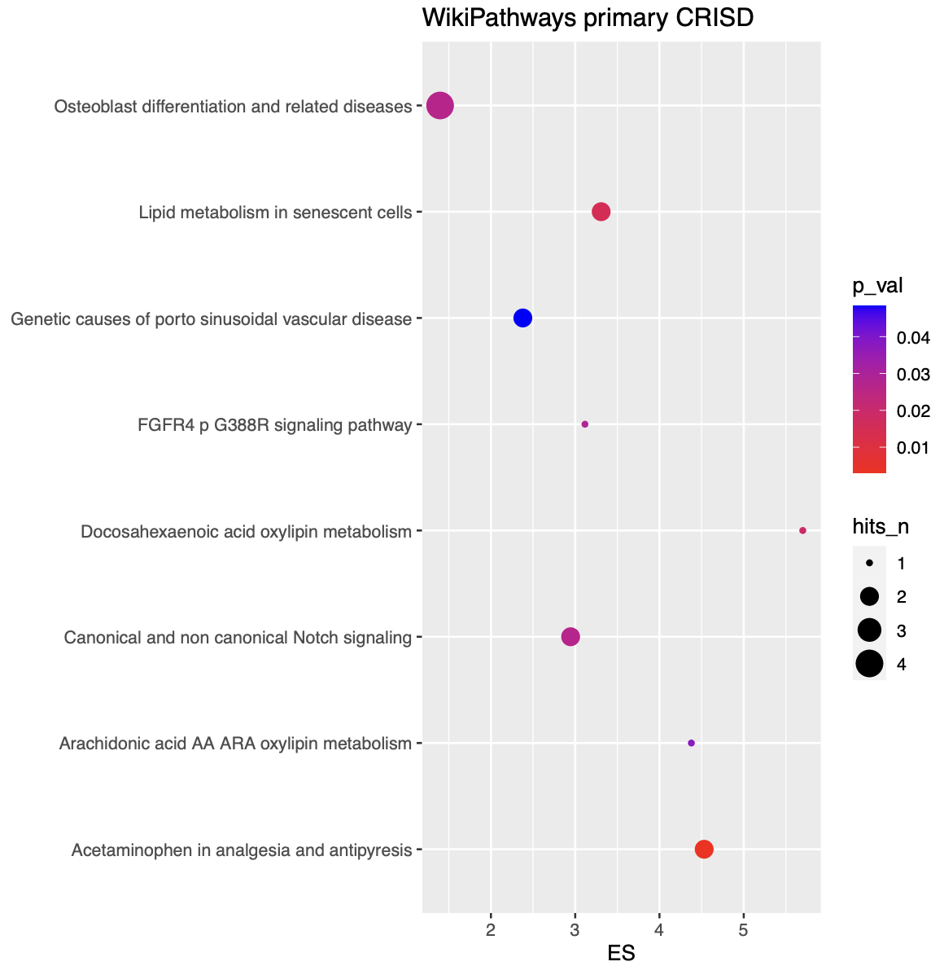
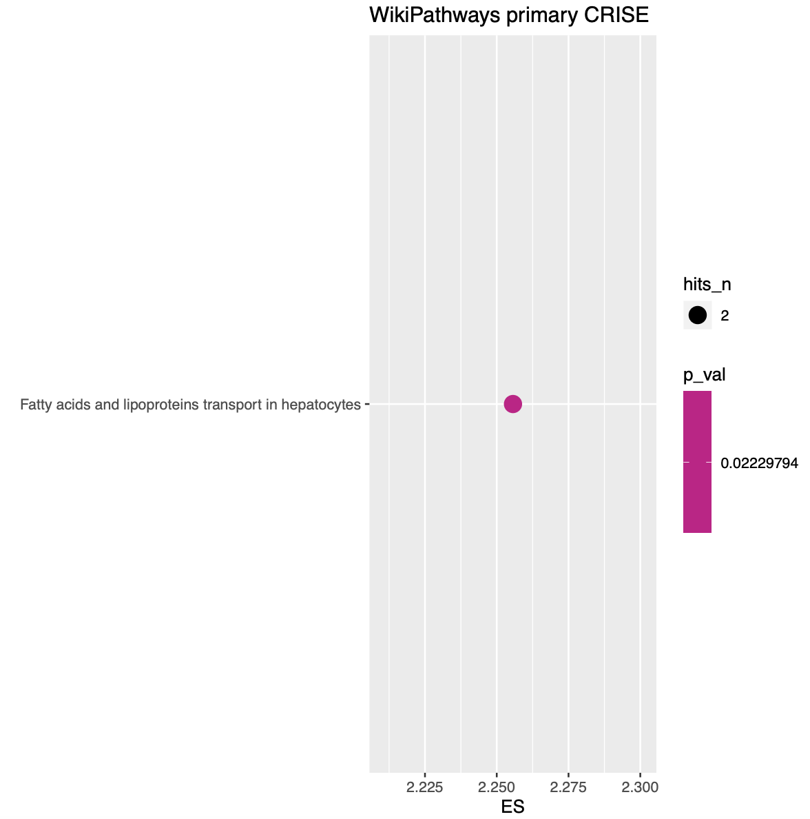
Cutoff 30% ACCORDING TO PRIMARY CRIS CLASSIFICATION

Slide 25
The pipeline
158 samples
STAR
IRFinder
Stringtie
Introns selected yb CNN with a IR-ratio
0.05 (default for IRFinder)
0.1
0.2
0.3
Detection and quantification of isoforms for each gene
Introns detected as exons in not annotated transcripts
CRIS CLASSIFICATION
Charachterization of transcriptional heterogeneity and alterantive splicing events
CRIS CLASSIFICATION
Not annotated introns with strong credibility
ANNOTATED
NOT ANNOTATED
Quantitative comparison among classes
Biotype evaluation
Quantitative comparison among classes
Quantitative comparison among classes
Comparison of biological interpretention ofintrons preferentially found in samples within a CRIS class
Poisson regression model
Ensembl gene informations
Functional analysis of differentially regulated genes
NOT ANNOTATED – ASSIGNED TO A GENOMIC REGION

Slide 26
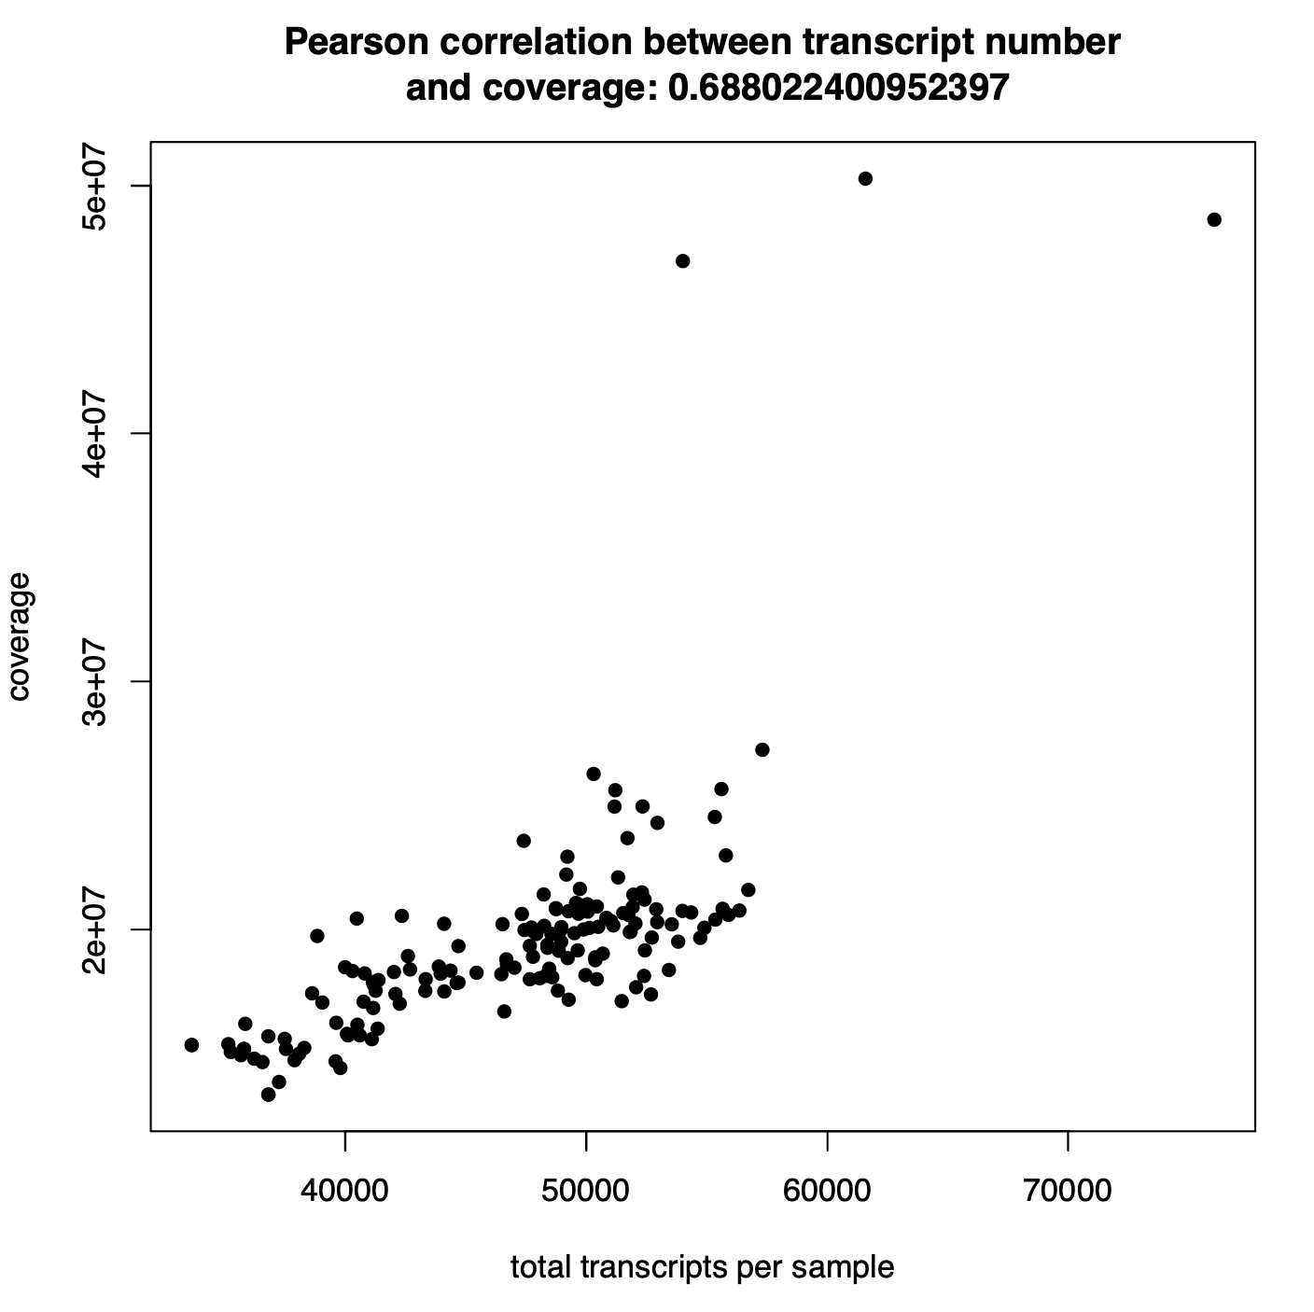
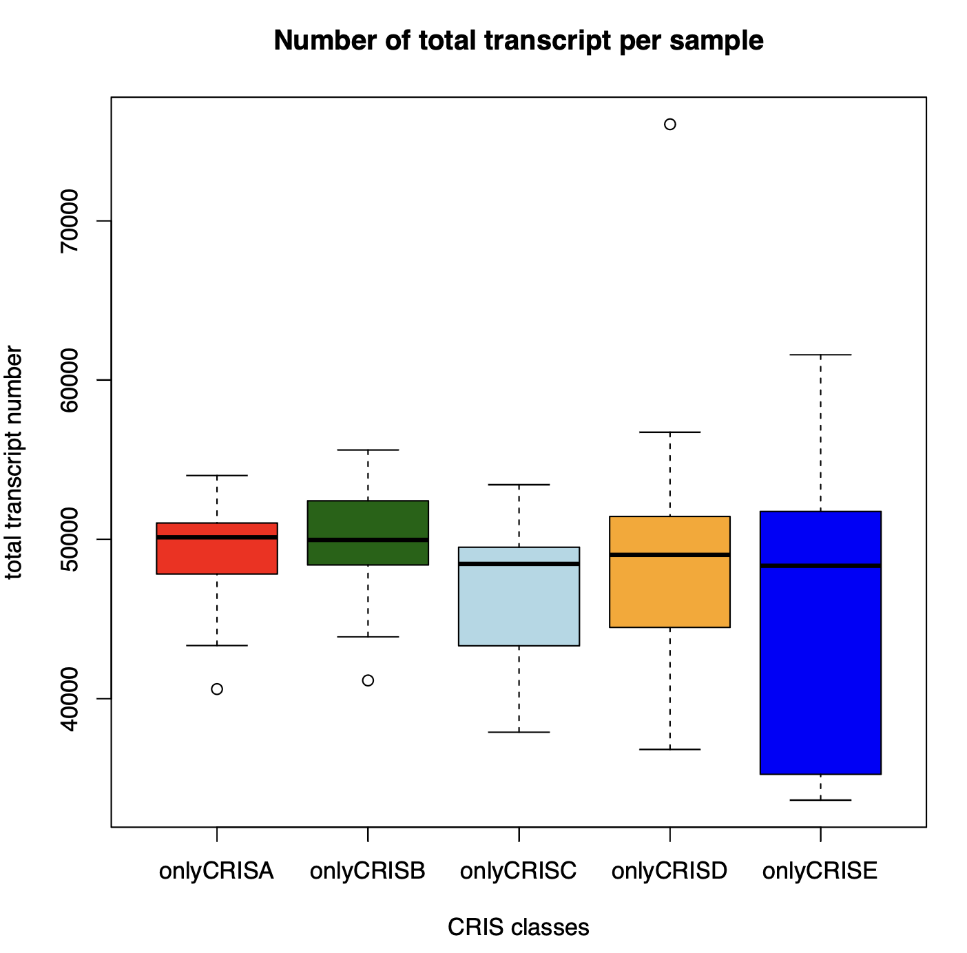
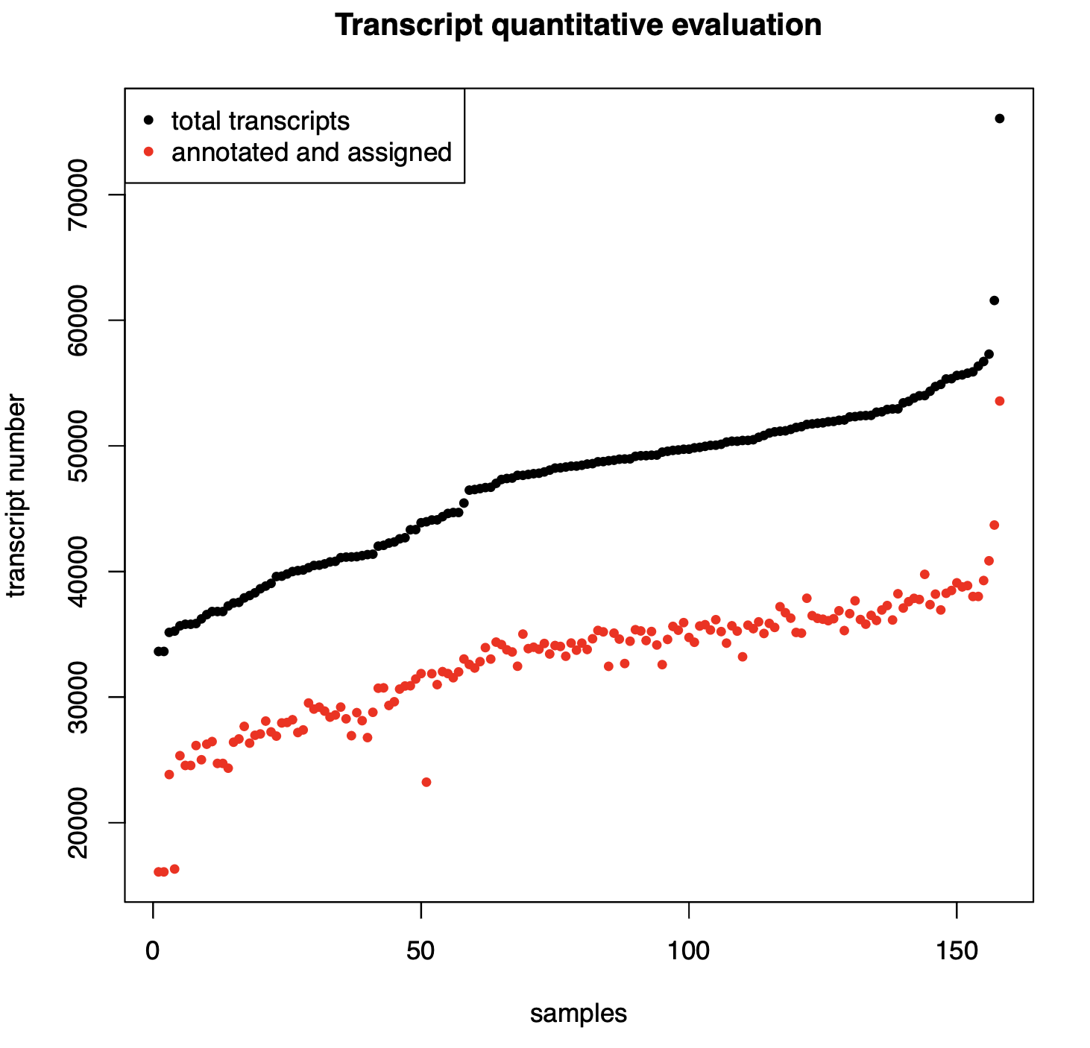
Quantitative transcript evaluation

Slide 27
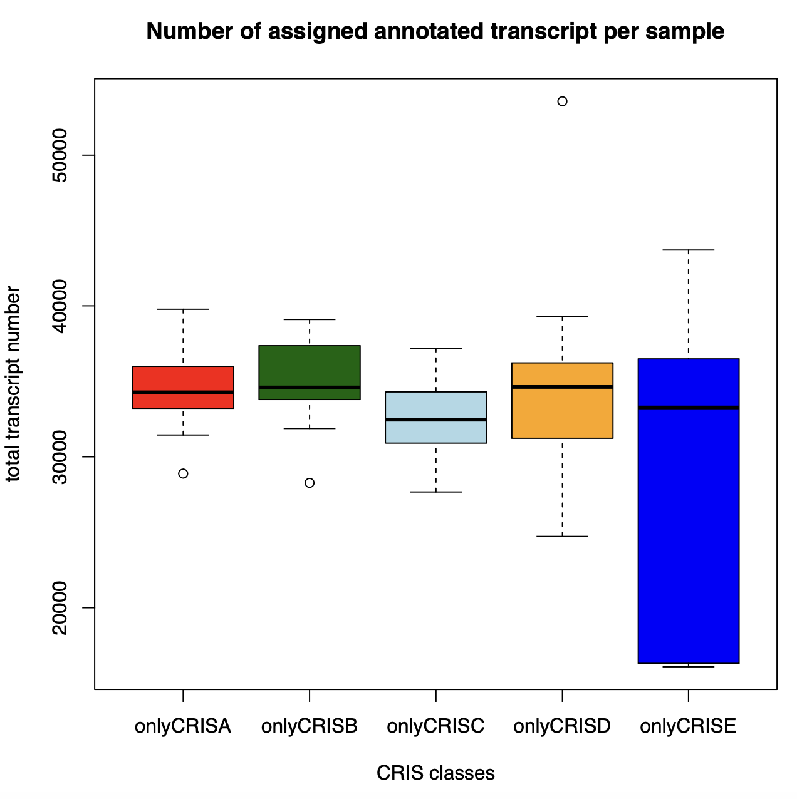
Annotated assigned trasncripts

Slide 28
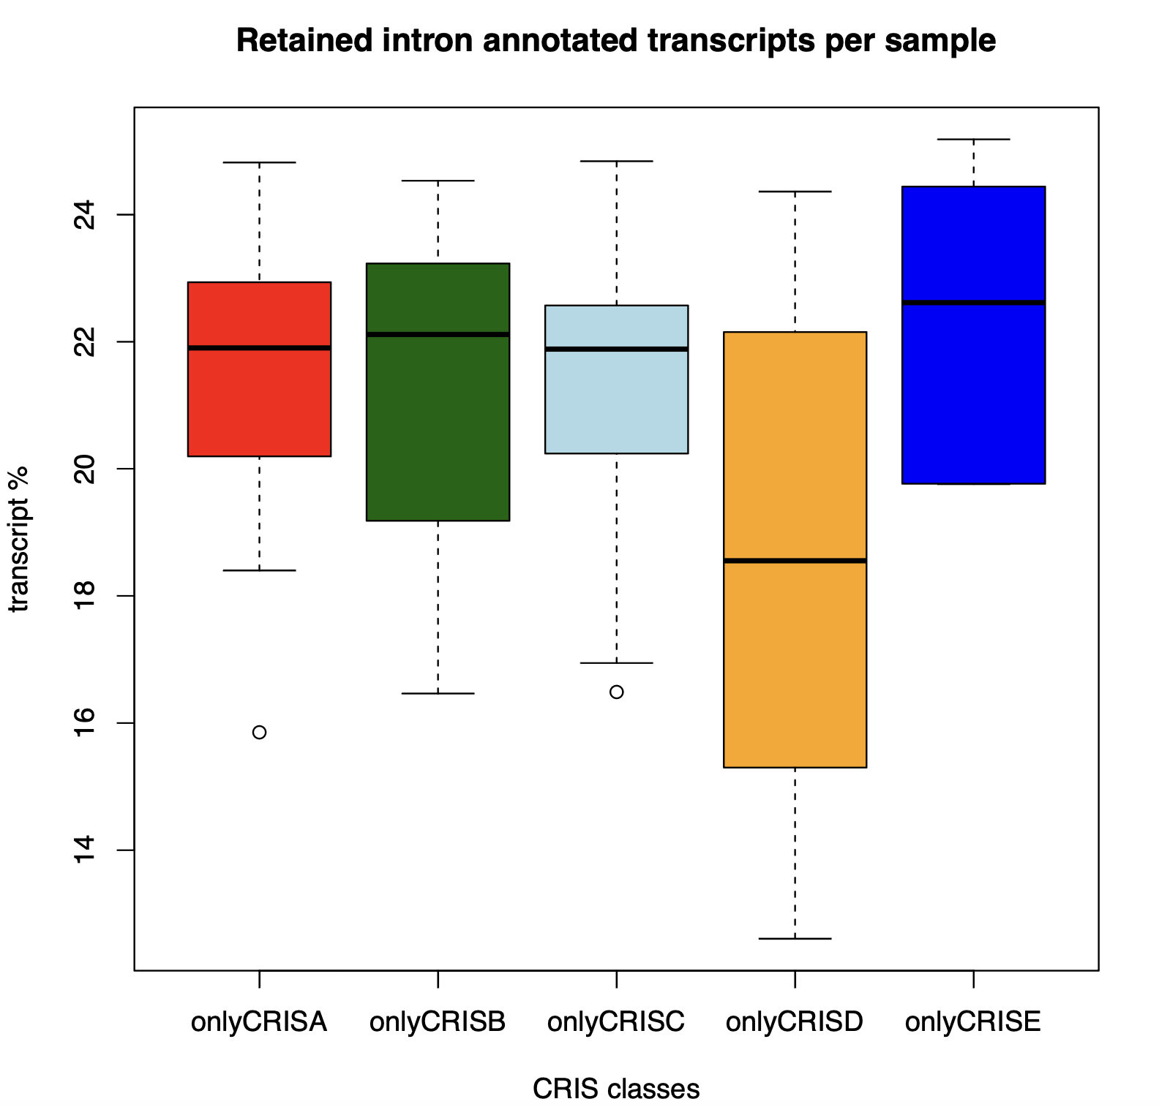
Biotype evaluation

Slide 29
Assignment of unannotated transcripts
ANNOTATED TRANSCRIPTS
Not annotated trasncripts
STRINGTIE GENE ID
STRINGTIE GENE ID
Matching STRINGTIE IDs
Selecting transcripts for which same GENE ID is always associated to the same ENSEMBL ID
Ensembl Gene information
OVERLAPPING GENOMIC REGIONS with > 90% identity
ENSEMBL ID
Transcripts without matching IDs
ASSIGNED UNANNOTATED TRANSCRIPTS
Univocally mapped
Non univocally mapped
Transcripts corresponding to IRFinder introns
Non assigned not annotated transcripts
Selection of candidates with higher identity

Slide 30
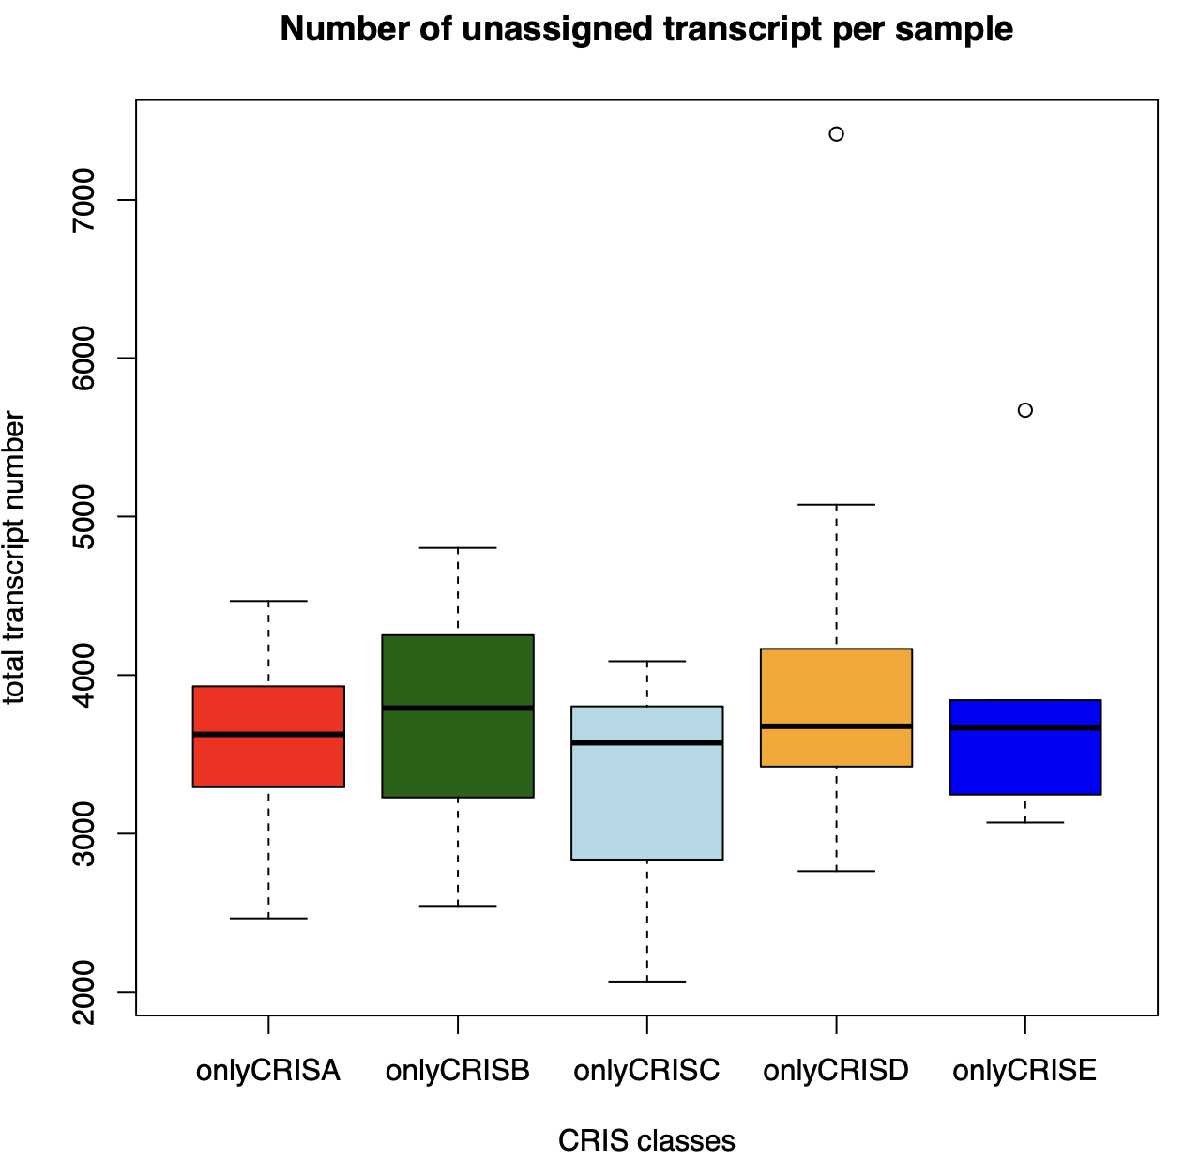
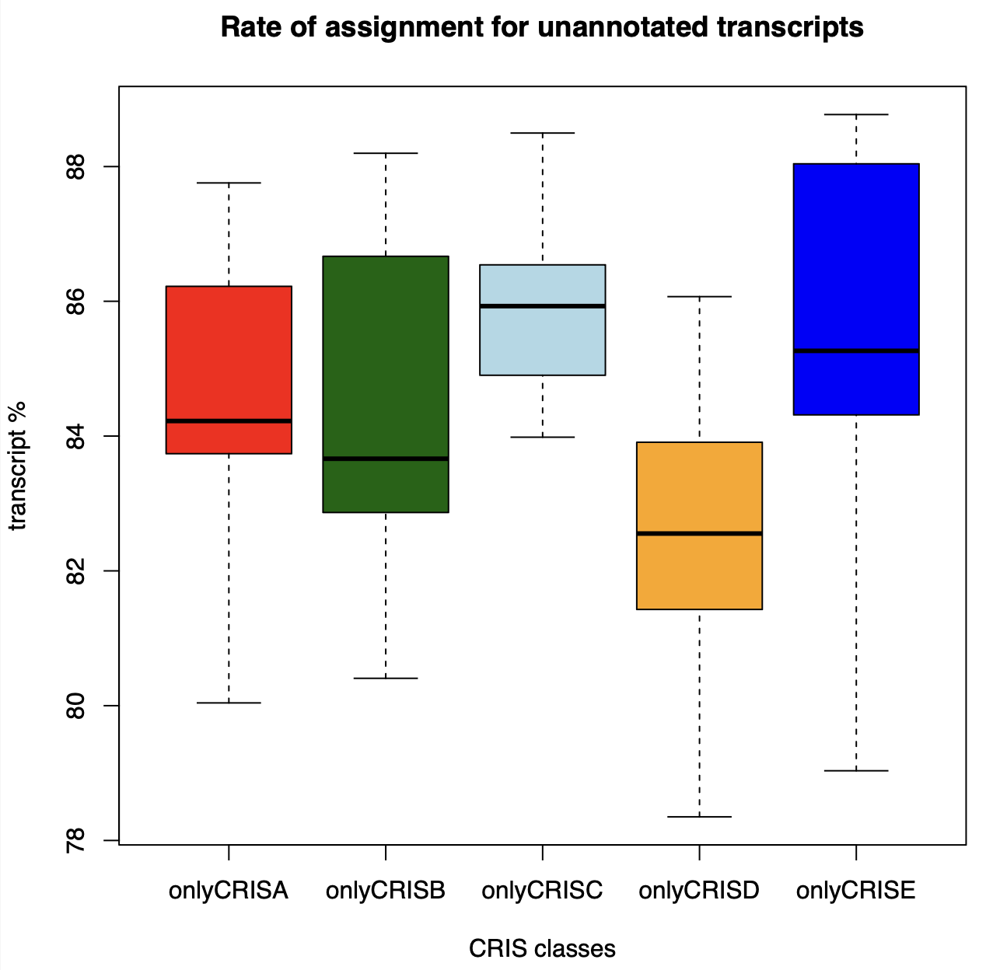
What is the drop out?

Slide 31
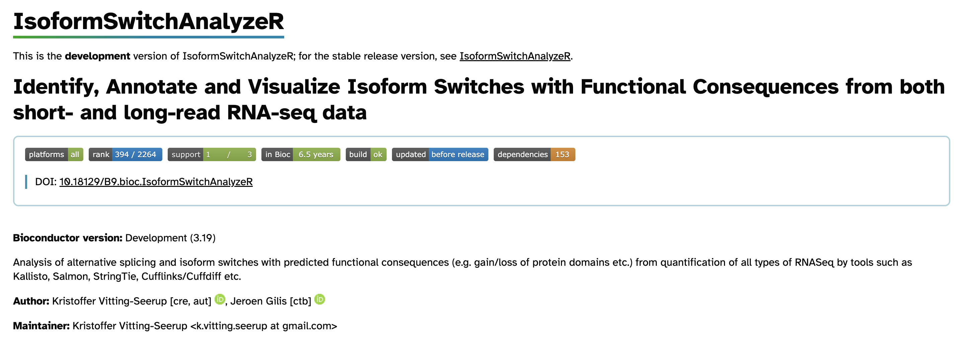
Could we do better?
The importIsoformExpression() + importRdata() function of the package can be used to import the expression and annotation data into R. During this import the package will attempt to clean up and recover isoform annotations where possible. It uses the following parameters:
fixStringTieAnnotationProblem A logic indicating whether to try and fix the following two annotation problems. • 1: Fix the problem where novel isoforms are not assigned to a refrence gene. This is done by assigning the gene_name of the parrent gene_id, but only when the gene_id is associated with a single gene_name. • 2: Fix the problem where multiple genes (as indicated by refrence gene_ids) are merged into a single gene_id. This can only be done when all isoforms are assigned a gene_name. The gene_id is simply split into multiple gene_ids via the gene_names. Genes with this problem, which could not be fixed, are removed since such constallations might result in untrustworthy switches (where the isoforms are acutally from different genes). • 3: Fix the problem where all genes containing novel isoforms are assigned a StringTie gene_id instead of their original id. This is done by assigning the gene_name of the parrent gene_id, but only when the gene_id is associated with a single gene_name.
fixStringTieViaOverlapInMultiGenes A logic indicating whether the IsoformSwitchAnalyzeR should also try to assign gene_names to novel isoforms within gene_ids with multiple gene_names associated. This is done by comparing the genomic overlap of exons in novel isoforms to exons in known isoforms. This is only done if all of the fixStringTieViaOverlap* cutoffs are met and fixStringTieAnnotationProblem=TRUE. Default is TRUE

Slide 32
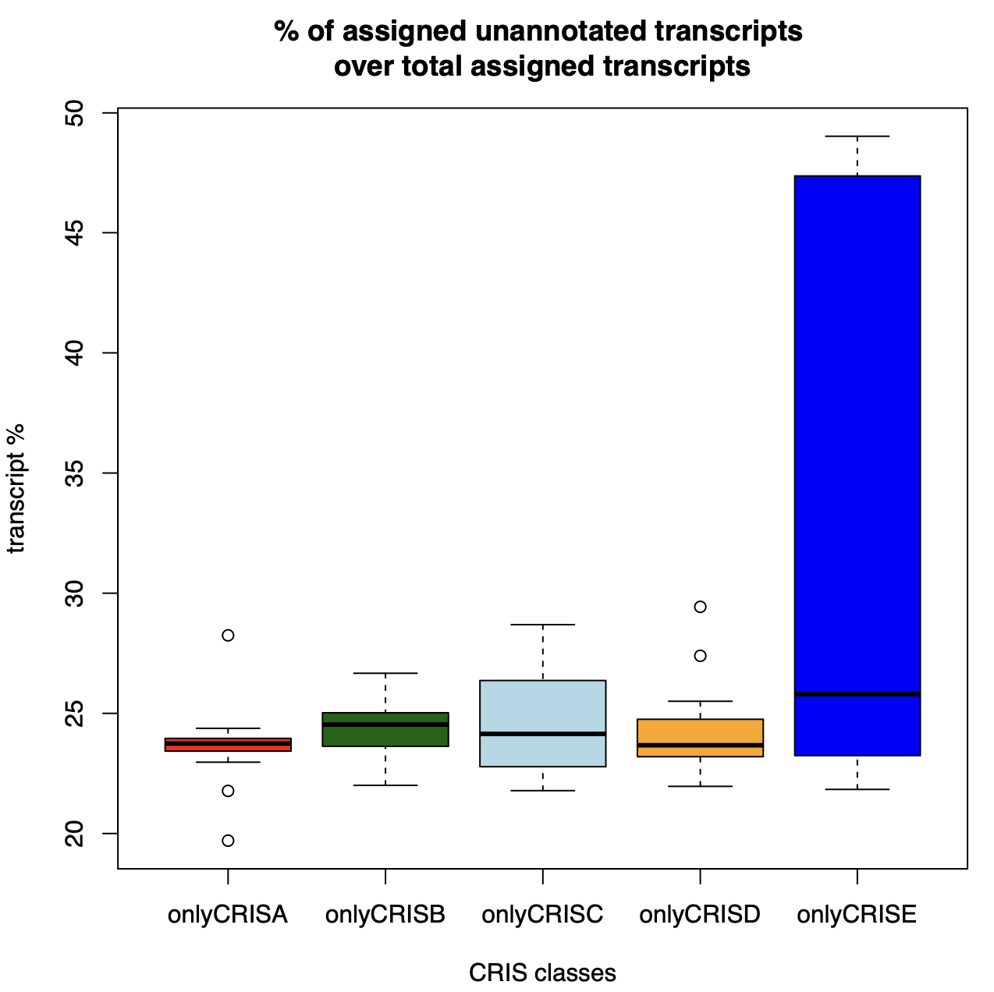
Relationship between annotated and unannotated transcripts

Slide 33
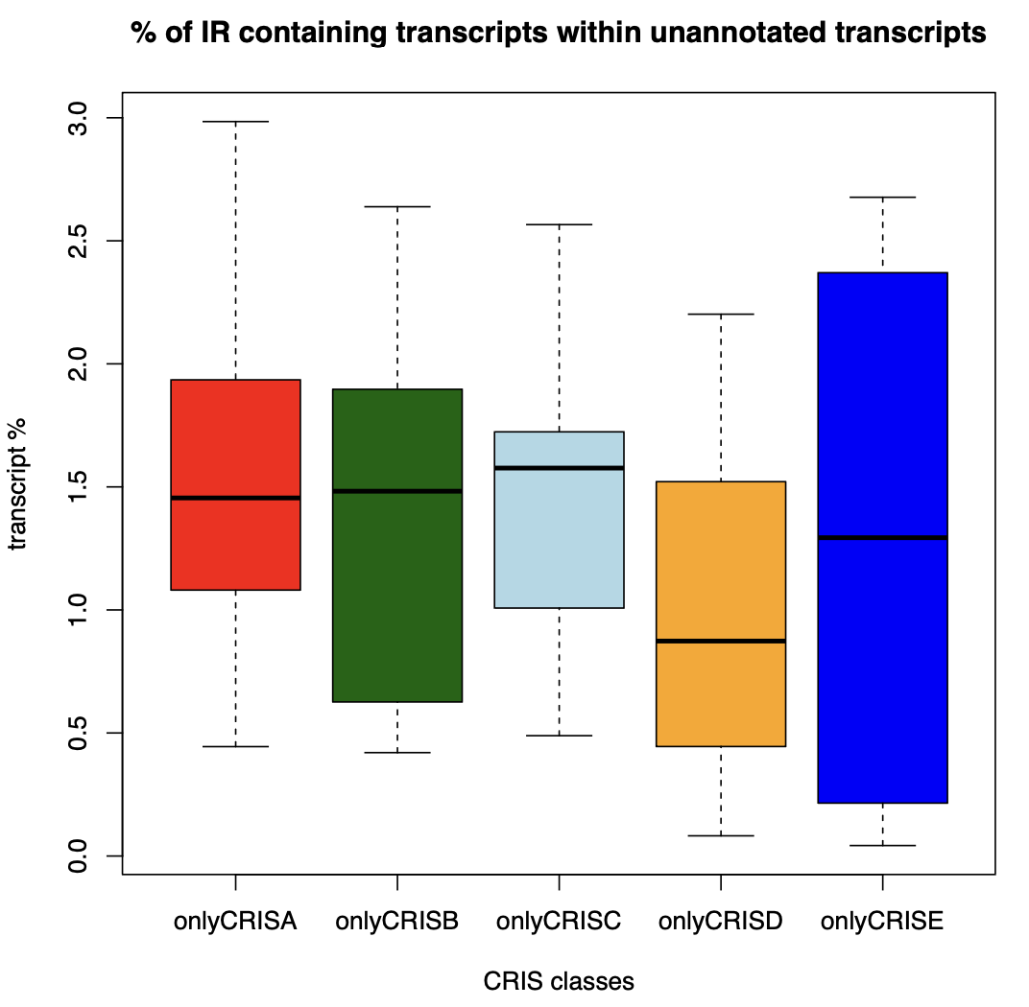
Relationship between unannotated transcripts and IR

Slide 34
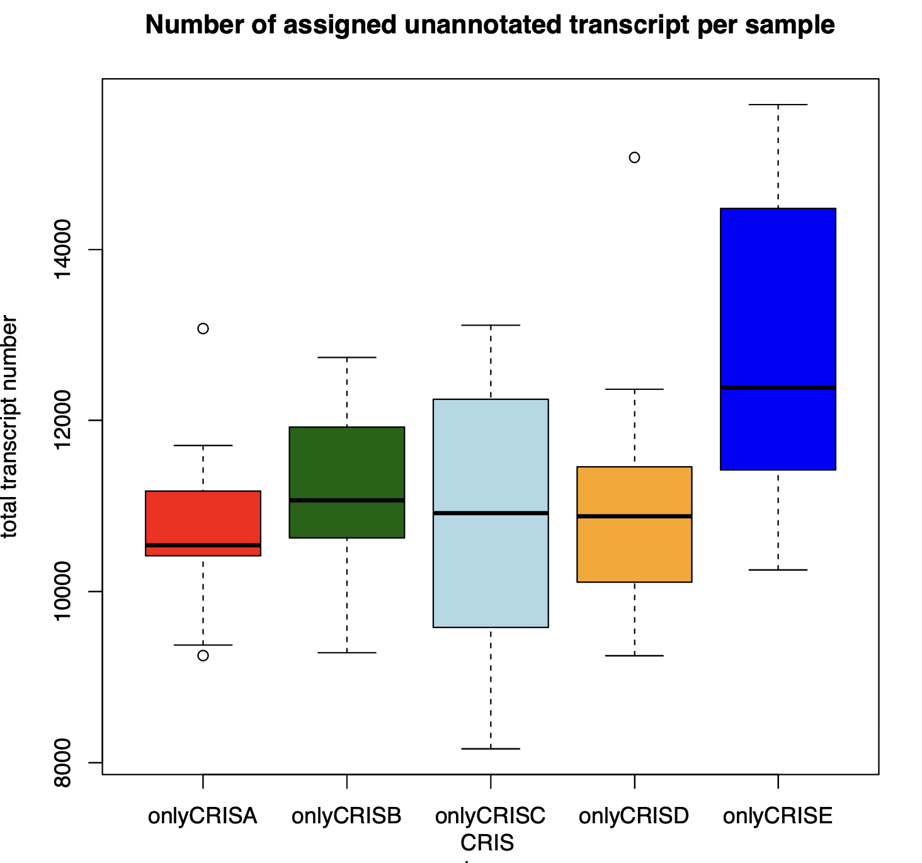
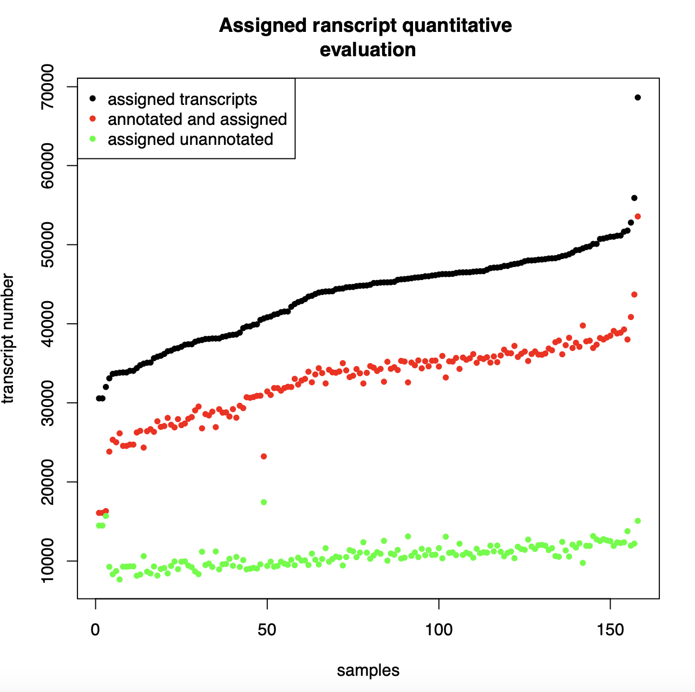

Slide 35
The pipeline
158 samples
STAR
IRFinder
Stringtie
Introns selected yb CNN with a IR-ratio
0.05 (default for IRFinder)
0.1
0.2
0.3
Detection and quantification of isoforms for each gene
Introns detected as exons in not annotated transcripts
CRIS CLASSIFICATION
Charachterization of transcriptional heterogeneity and alterantive splicing events
CRIS CLASSIFICATION
Not annotated introns with strong credibility
ANNOTATED
NOT ANNOTATED
Quantitative comparison among classes
Biotype evaluation
Quantitative comparison among classes
Quantitative comparison among classes
Comparison of biological interpretention ofintrons preferentially found in samples within a CRIS class
Poisson regression model
Ensembl gene informations
Functional analysis of differentially regulated genes
NOT ANNOTATED – ASSIGNED TO A GENOMIC REGION

Slide 36
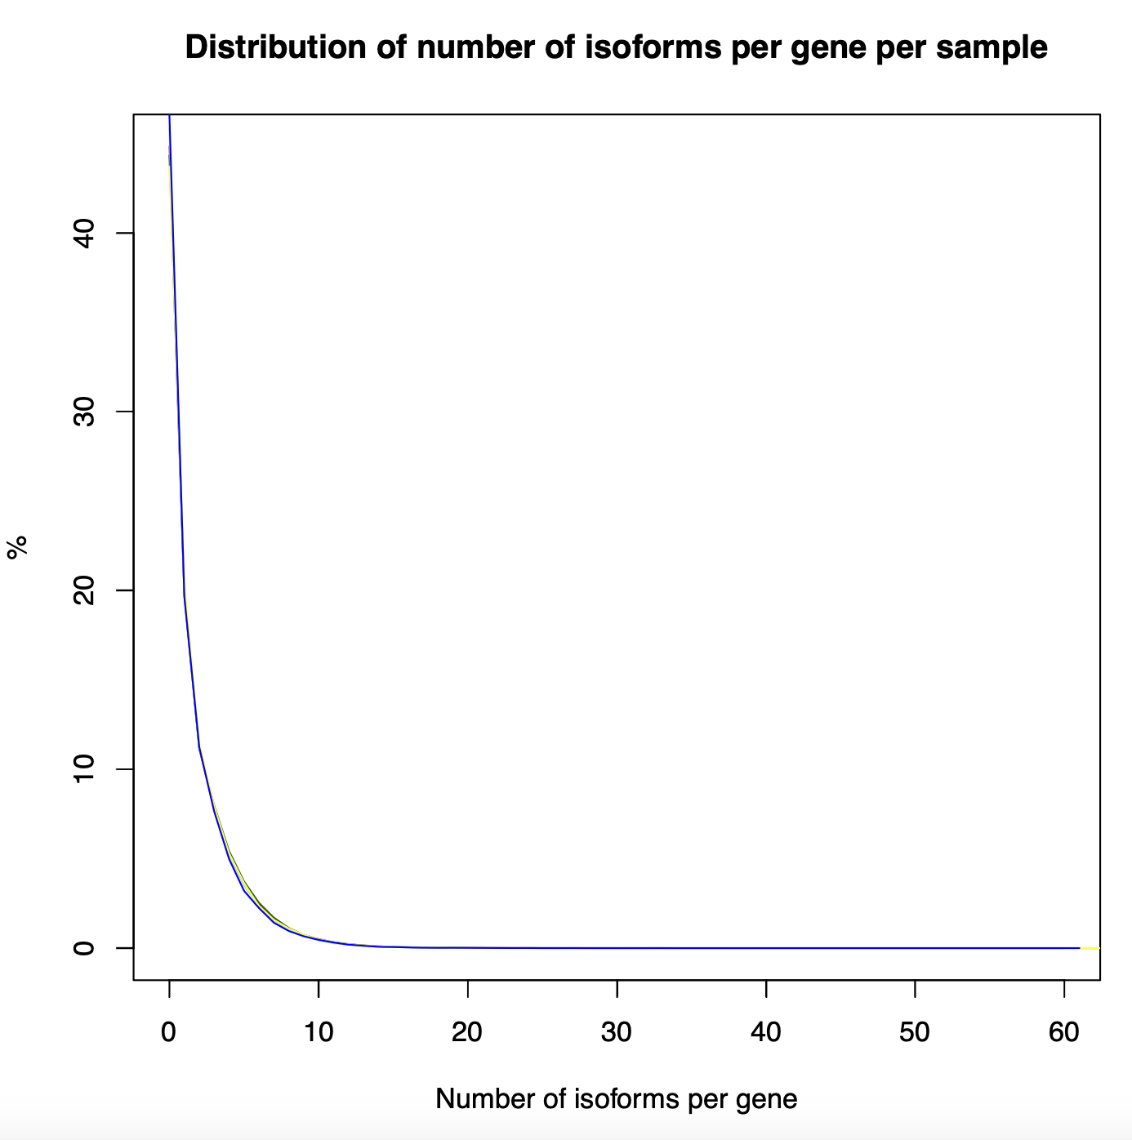
MODELLING
Poisson regression fit for each gene for each CRIS class
Log2ratio calculation among groups
Selection of genes with a p-value < 0.05 & L2R >1 within each class
p-value calculated by fisher test
Log2ratio calculated as Log2 Observed/Expected
Gene sets filtered according to genes detectable in saples
Enrichment analysis with gene sets from WikiPathways

Slide 37
RESULTS
CRIS A
CRIS B

Slide 38
RESULTS
CRIS C
CRIS D
CRIS E

Slide 39
Experimental VAlidation

Slide 40
Potential cell lines
CRIS E
CRIS E
CRIS A
CRIS A
CRIS A
CRIS A
CRIS A
CRIS D
CRIS D
CRIS D
COGA2.STAR
HROC183.STAR
V411.STAR
HROC24S4.STAR
IRCC22.STAR
LS180.STAR
LS180S23.STAR
SW620.STAR
HROC57.STAR
HUTU80.STAR
Coverage between 50° and 75° percentile
Coverage above 75° percentile

Slide 41

Is transcript expression level related to reproducibility in replicates? What to expect
Answer is not univocal, testing is best

Slide 42


In order of decreasing expression
chr5:179621035:179621241:-:HNRNPH1
chr17:64500326:64500548:-:DDX5
chr5:179618323:179619268:-:HNRNPH1
chr5:179621035:179621241:-:HNRNPH1
chr16:31185179:31186801:+:FUS
chr5:179621397:179623036:-:HNRNPH1
chr11:69816423:69818713:-:FGF3

Slide 43

How does this lack of reproducibility look like?
Not selected as IR
Lower % and less reads spanning the intron
SW620.STAR
SW620S14.STAR
Selected as IR
chr5:179621035:179621241:-:HNRNPH1

Slide 44


Not selected Very large intron, a lot of reads in the middle, a lower% of reads spanning the junction
LS180.STAR
LS180S23.STAR
Selected
chr1:211365468:211369451:+:TRAF5
Not selected as IR
Lower % and less reads spanning the intron
LS180.STAR
LS180S23.STAR
Selected
chr17:64500326:64500548:-:DDX5

Slide 45
Validating intron retention
chr20:2862934:2863064:+:VPS16
chr11:3104377:3107262:-:OSBPL5 or chr6:30640603:30642175:+:ATAT1
chr14:24058986:24059134:+:CARMIL3
chr1:211365468:211369451:+:TRAF5
LS180.STAR LS180S23.STAR
Similar expression in both, around 4 TPM Good for validating reproducibility among replicates. Also, no other cell should express it
COGA2.STAR HROC183.STAR
Expression between 5 and 10, good example of class specificity in CRIS E
Class specificity in CRIS D, validation of ability to detect introns which are around 1 TPM. Expression is almost identical in both cell lines
SW620.STAR HROC57.STAR
All samples
Detecting dynamic range, expression between 2 and 60 for LRRC45 and up to 100 for TRAF

Slide 46

Why and how do they look like
TPM
Dynamic range assesment
Charachteristic of a class
Not reproduced in replicates

Slide 47




Validating stringtie variants
CD44 not annotated isoforms are common and have a high expression level in samples, however we cannot reconduct them to specific annotated isoforms
MRPL33 two isoforms have been detected, a short one and a long one, (pro-proliferative and anti apoptotic) containing or skipping exon 3. They are annoated and we can detect them with StringTie
PCR primers can be used to detect them and their ratio, to see if data from stringtie is reliable
In both LS180 and LS180S23 it’s the more abundant in LS180 there are also traces of intron retaining isoforms, which however do not reach 1 FPKM This potentially depends on the sequencing, giving the read based nature of the assembly

Slide 48
What is the distribution within the Samples?

Slide 49
What about kras

Slide 50



How to design primers?
Visualize intron retention isoforms on UCSC starting from bed file obtained from stringtie output.gtf
Get FASTA sequence of region of interest with ”Table Browser” tool
Subset FASTA sequence overlapping intron and use Primer3 or PRIMER-BLAST to predict the best primer couple
For intron retention transcripts, test the amplified region with “In silico PCR”

Slide 51

Other results: CARMIL3

Slide 52

OTHER RESULTS: TRAF5

Slide 53


MRPL33
Exon 3 inclusion isoform
Short isoform

Slide 54
Yet to design
chr16:31185179:31186801:+:FUS
chr17:64500326:64500548:-:DDX5
chr11:69816423:69818713:-:FGF3

Slide 55

What could we do next
Investigating differential transcript usage

Slide 56



SatuRn
# Get the transcript information in correct format
#Remove transcripts that are the only isoform expressed of a certain gene from the transcript expression matrix

Slide 57


COUNTS are needed: how to get them?
What does StringTie suggest:
Available in a table, provided by stringtie
For annotated transcripts (those of interest) it can be calculated from ensembldb database
By default both tximport package and the stringtie proposed script uses 75

Slide 58



#filtering criterion (implemented in the R package edgeR)
# Update txInfo according to the filtering procedure
# remove txs that are the only isoform expressed within a gene (after filtering)
Create a design matrix
#Generate SummarizedExperiment (thanks to SummarizedExperiment package )

Slide 59



#fitDTU function of satuRn is used to model transcript usage in different groups of samples or cells. Here we adopt the default settings of the function
Set up contrast matrix

Slide 60
For CRIS it would look like this:
 | Contrast 1 | Contrast 2 | Contrast 3 | Contrast 4 | Contrast 5
onlyCRISA | 1 | -1 | -1 | -1 | -1
onlyCRISB | -1 | 1 | -1 | -1 | -1
onlyCRISC | -1 | -1 | 1 | -1 | -1
onlyCRISD | -1 | -1 | -1 | 1 | -1
onlyCRISE | -1 | -1 | -1 | -1 | 1

Slide 61


#perform differential usage testing using testDTU

Slide 62
Building a heatmap and understanding results
How to get isoform fraction value (tips from IsoformSwitchAnalyzer):
For each gene in each replicate sample the expression of all isoforms belonging to that gene (as annotated in \code{isoformExonAnnoation}) are summed to get the gene expression. It is therefore very important that the \code{isoformRepExpression} is unfiltered. For each gene/isoform in each condition (as indicate by \code{designMatrix}) the mean and standard error (of mean (measurement), s.e.m) are calculated. Since all samples are considered it is very important the \code{isoformRepExpression} does not contain technical replicates
isoform fraction (IF) values are calculated as <isoform_exp> / <gene_exp>

Slide 63
If the validation proves to be sustaining the data there are no significative differences in the absolute amount of intron retention or transcriptamong classes, altough CRIS D is on the lower end of intron retention (both known and unknown) and alternative transcript usage, suggesting a protective role in the overexpression of spliging regulator genes
Qualitative differences in the phenomena can be seen, however the enrichment is mostly based on a limited amount of genes
Rather than convergence, a high variability can be seen in the intron retention events, both in replicates and among classes. No key event was shared among all the sample in a determined class
Identification of potential neoantigens form unknown transcripts could help in elucidating the role of these events, and help in explaining the heterogeneity in the immune response
CONCLUSIONS

